Slide 1


Investment Area 4.2
Rural Regeneration and Social Inclusion
PEACEPLUS Programme

Slide 2
PEACEPLUS Programme
Investment Area 4.2 – Rural Regeneration and Social Inclusion
Introduction & Housekeeping – Karyn McNiece, SEUPB
Welcome & Overview of PEACEPLUS Programme - Declan McGarrigle, Interim Director of PEACEPLUS Development
Overview of Policy Interests from Ireland – Rosie Smyth, Dept of Rural and Community Development
Overview of Policy Interests from Northern Ireland – Gareth Evans, Dept. of Agriculture, Environment and Rural Affairs
Overview of Investment Area 4.2, Pre-Application Support & the Concept Note – Lorraine McCourt, Lorraine McCourt Consulting
Questions and Answers
Notes:
**HOLDING SLIDE - AGENDA**
Good morning and thank you for joining us today.
We are delighted to welcome you to our tenth pre-application workshop for the PEACEPLUS Programme – Area 4.2 Rural Regeneration and Social Inclusion
Similar support will continue be offered for the other areas of the Programme in the following weeks and months. Keep a look at our website and social channels for all updates.
Before we get into the main content of today’s workshops, I’ll take you briefly take you through the agenda…..
Then I will move onto providing an overview of Area 4.2, the Rural Regeneration and Social Inclusion Programme.
Lorraine McCourt will take you through the steps in building a strong proposal, and provide some broad parameters as to how things might roll out over the next six months.
There will also be an opportunity to ask questions at the end of the presentations and todays session, so please keep hold of your questions until the Q&A section. All answers will be added to the FAQs on our website.

Slide 3
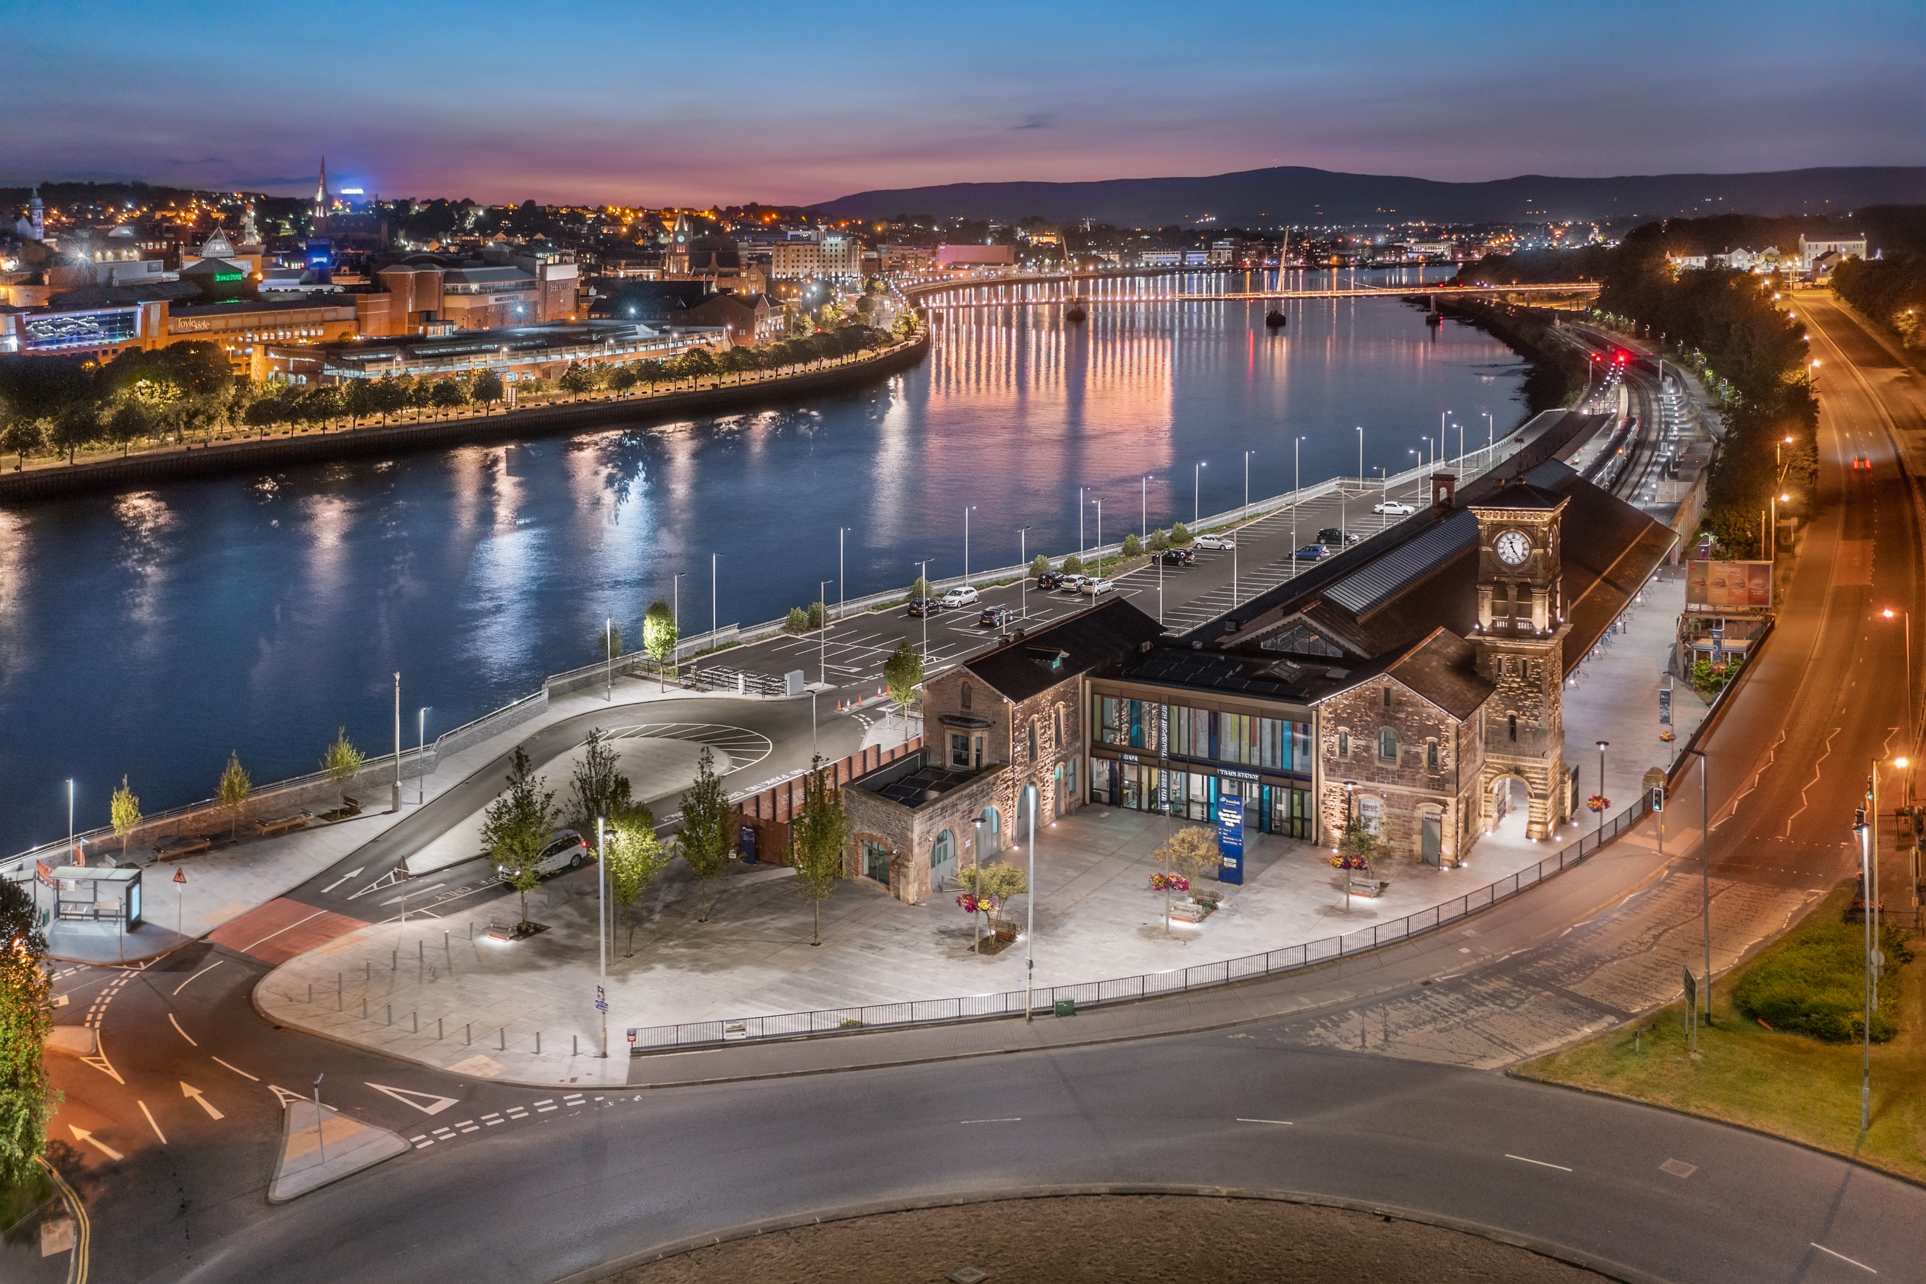
PEACEPLUS Programme
Declan McGarrigle, SEUPB
Interim Director PEACEPLUS

Slide 4

PEACEPLUS Context: How did we get here?
Support of the NI Executive, the Government of Ireland, the UK Government and the European Union.
Building upon previous PEACE & INTERREG programmes.
Renewed focus on peace and reconciliation.
Ensuring all projects contribute to cross-border and economic and territorial development.
Notes:
We have reached this point through a detailed process of collaboration with the Northern Ireland Executive, the Government of Ireland, the UK government, and the EU.
Together, we have drafted a new Programme that will contribute to a more peaceful, prosperous and stable society in Northern Ireland and the border region of Ireland. We believe it will leave a significant and lasting legacy.
It is an exciting programme which builds on the legacy of all previous PEACE and INTERREG programmes.
PEACEPLUS funding is distinct. It will fund activities that promote peace and reconciliation and contribute to cross-border economic and territorial development.

Slide 5
How was PEACEPLUS Developed?
Intensive review, research and public engagement
Stakeholder engagement
Public events – including specific events with young people
Survey submissions
Public consultation (2021)
Bi-laterals with government north-south (ongoing)
Notes:
So how was PEACEPLUS developed?
It has been a long road in getting to this point, but, given the scale and scope of the Programme, it has been well worth it.
The SEUPB commenced the PEACEPLUS development process in 2019. Since then, there has been considerable preparatory work, research, and stakeholder engagement.
This has included: public events, survey submissions, public consultation, and ongoing bi-lateral meetings with Governments north-south.

Slide 6
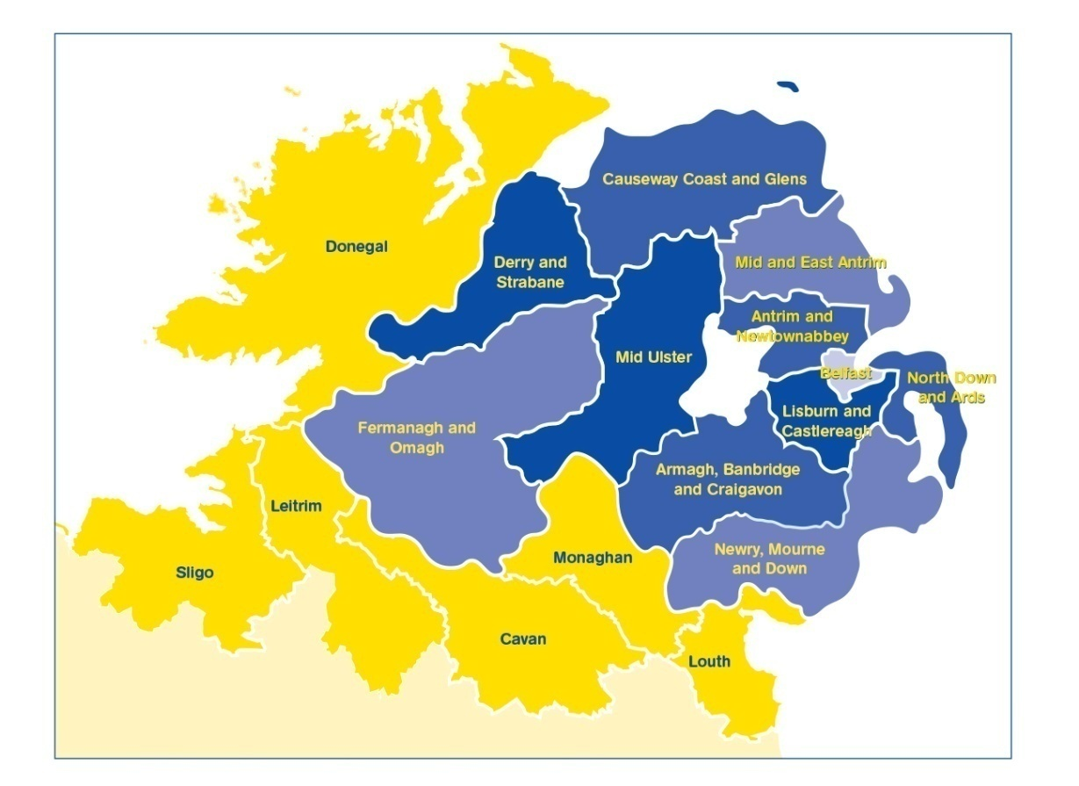
PEACEPLUS (2021-2027)
Programme area: Northern Ireland & the border counties of Ireland
Programme value: €1.144 billion
Six themes, 22 investment areas
Participation from partners outside the area
Notes:
The Programme will:
continue to take the opportunities and address the needs arising from the peace process in order to boost economic growth and stimulate social and economic regeneration; and,
and
promote social inclusion, particularly for those at the margins of economic and social life.
The value of the programme, over seven years, is €1.144bn
The ERDF contribution (80%) has been matched by the UK and Irish governments. This means that applicants can apply for 100% of their project value.
It is a wide-ranging Programme with six themes and 22 investment areas.
All investment areas have a sharp focus on the peace impacts and legacy they will leave.
Cross-community and cross-border collaboration is key to the programme, and all projects must have demonstrable peace impacts.
Commission rules allow for participation with partners outside the area of Northern Ireland and the Six Borders Counties. If you are considering partners from outside the region, what matters is that the benefits of the project are significant for the Programme area.

Slide 7
PEACEPLUS
Peace
Prosperity

Slide 8
Programme Overview:
Where does Rural Regeneration and Social Inclusion fit in?
Theme 1
Building Peaceful and Thriving Communities
€250m
Theme 2
Delivering Socio- Economic Regeneration & Transformation
€170m
Theme 3
Empowering and Investing in Our Young People
€123m
Theme 4
Healthy and Inclusive Communities
€172m
Theme 5
Supporting a Sustainable Future
€303m
Theme 6:
Building and Embedding Partnership and Collaboration
€52m
Thematic Areas
1.1 Co-designed Local Community Peace Action Plans
1.2 Empowering Communities
1.3 Building Positive Relations
1.4 Reimaging Communities
2.1 Programme Area SME Development and Transition
2.2 Programme Area Innovation Challenge Fund
2.3 Programme Area Skills Programme
2.4 Smart Cities, Towns and Villages
3.1 Shared Learning Together Education Programme
3.2 PEACEPLUS Youth Programme
3.3 Youth Mental Health
4.1 Collaborative Health and Social Care
4.2 Rural Regeneration and Social Inclusion
4.3 Victims and Survivors
5.1 Biodiversity, Nature Recovery and Resilience
5.2Marine and Coastal Management
5.3 Water Quality and Catchment Management
5.4 Water Quality Improvement Programme
5.5 Geothermal
5.6 Transport
6.1 Strategic Planning
6.2 Maintaining and Forging Relationships between Citizens
Investment Areas

Slide 9
Project Lifecycle
PREDEVELOPMENT
Elaboration of project idea, concept note, partner search
Call
PROJECT CLOSURE
PROJECT DEVELOPMENT AND APPLICATION
Strategy and content, responsibilities, application requirements
Final reporting, post-project activities, use of results
Project assessment and selection
Modification assessment and selection.
Monitoring achievement.
PROJECT IMPLEMENTATION
CONTRACTING AND START-UP
Letter of Offer, Partnership Agreement, kick off, detailed planning, conditions
Coordination of activities, reporting, monitoring, modifications, evaluation, financial management, communication
Notes:
Pink diamonds: Some key points where programme committees have a role in.
All projects, regardless of the type (from previous slide) have the same project lifecycle

Slide 10
PEACEPLUS
Rural Regeneration and Social Inclusion Programme
Theme 4. Healthy and Inclusive Communities (€172m)
4.1 Collaborative Health and Social Care
4.2
Rural Regeneration and Social Inclusion
4.3
Victims and Survivors

Slide 11
Policy Perspective/Considerations
Investment Area 4.2 Rural Regeneration and Social Inclusion
Workshop 15th March 2023
Accountable Department of Rural and Community Development

Slide 12
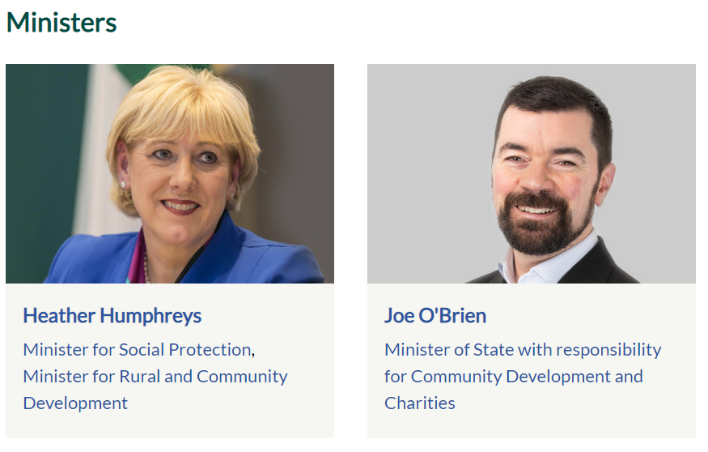

Slide 13
The Department of Rural and Community Development’s mission is to promote rural and community development and to support vibrant, inclusive and sustainable communities throughout Ireland.
Our Vision is a sustainable society with individual and community wellbeing at its heart, supporting thriving rural communities, and where all communities, urban and rural, have opportunities to grow together and develop economically, socially and culturally.
A key objective of all the programmes under our Department’s remit, is that they are targeted at those sectors and areas most in need; acknowledging the ongoing and future economic and social challenges we face, as a result of a number of contributing factors.

Slide 14
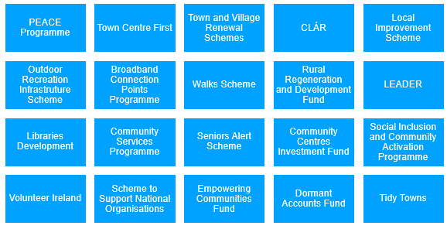
DRCD’s Programmes

Slide 15
DRCD’ engagement on PEACE Programmes
Our Department is an Accountable Department for a number of thematic areas under the PEACE IV Programme and under PEACEPLUS we are an Accountable Department for a number of Investment Areas including Rural Regeneration and Social Inclusion.
The objective of this investment area is to create a more cohesive society through an increased provision of community spaces, key services and supports in rural areas.
Many of you here today have played a leading role in the delivery of PEACE Programmes over the years and have had good success in the designing and development of programmes and in the delivery of infrastructure within your areas for the provision of services and supports; including those that promote outdoor activities and support enterprise and tourism.

Slide 16

Navigating EU funding can be challenging. Access Europe which is run by The Wheel, builds the capacity and supports the development of partnerships between Irish civil society organisations and European partners, as well as the creation of networks promoting participation in EU programmes and policy-making, including PEACEPLUS.

Slide 17


iCommunity focuses specifically in North/South collaboration and bringing communities together to explore shared challenges, to come up with new ideas and responses that could become joint projects.

Slide 18

New Decade, New Approach
The Irish Government is committed to working with the Northern Ireland Executive, through the North/South Ministerial Council, to help deliver projects that will benefit people across the island of Ireland, North, South, East and West;

Slide 19
Advice and Guidance
You will need to ensure that the new proposals and programmes are aligned with the relevant Government and EU Strategies/Policies, and Local and County Development Plans where there are proposals for the development of infrastructure or facilities.
This investment area places particular emphasis on supporting social, economic and environmental projects which contribute to sustainable regeneration, social inclusion and the creation of healthy and thriving communities in rural areas.
PEACEPLUS is additional funding and should not displace core public funding already provided. It should not duplicate other existing funds and so project proposals need to outline how the project will directly contribute to peace and reconciliation, they must have a clear peace focus.

Slide 20

Ireland – Key Documents

Slide 21
Ireland – Key Strategy Documents
Programme for Government: Our Shared Future
We have committed to
working with our EU partners and UK Government to secure the necessary funding for the EU PEACEPLUS Programme;
contributing to peace-building initiatives;
working with all communities and traditions on the island to build consensus around a shared future.

Slide 22
Project Ireland 2040
It is a combination of the National Development Plan which sets out the investment priorities that will underpin the implementation of the National Planning Framework and submissions should demonstrate relevance to Project Ireland 2040.
It recognises that investment is required in rural areas for access to quality services and enhanced amenities such as trails and greenways.
Facilitate the development of the rural economy through supporting the agricultural sector together with the bio-economy and diversification into alternative on-farm and off-farm activities, while at the same time noting the importance of maintaining and protecting the natural landscape and built heritage which are vital to rural tourism;
Integrated planning for green infrastructure to be incorporated into the preparation of statutory land use plans and through integrated land use and spatial planning that supports public transport, walking and cycling as more favourable modes of transport to that of the private car.

Slide 23
Ireland – Key Strategy Documents continued
Our Rural Future: Rural Development Policy 2021 – 2025 focuses on:
optimising the opportunities for rural communities, assisting the regeneration and development of rural towns and villages;
enhancing public services in rural areas,
putting the future development and regeneration of rural towns at the heart of decision making through the Town Centre First approach and investing significantly in the revitalising of rural towns and villages.

Slide 24
Ireland – Local Authority Specific
Local Development Plans
Identify the planning and sustainable development of the county over the lifetime of the plan.
Provide an overall strategy for the social, economic, cultural and physical development of the county, including improvements to local amenities.
They must be compatible with National and Regional Planning Strategies including the National Planning Framework and Regional Spatial and Economic Strategies.
Are complementary to the Local Economic and Community Plans which are currently under consultation and development in each Local Authority area in the border region of Ireland.

Slide 25
Roadmap for Social Inclusion 2020 – 2025
The Roadmap for Social Inclusion sets out goals to measure progress across many aspects of social inclusion, including
social integration and empowering communities to address social exclusion,
ensuring that all people have access to quality services;
with the overall objective of achieving a better quality of life for all.
It outlines that community and voluntary groups leverage the energy, know-how and local knowledge of local volunteers to step-up and give their time both to provide critical local services and to advocate for improved services.

Slide 26
Realising our Rural Potential
The Action Plan for Rural Development highlights the potential of activity tourism to contribute to economic growth in rural areas.
The development and promotion of this sector provides opportunities for growth, in rural areas in particular, by facilitating businesses to leverage the tourism assets in their area in a sustainable way to support recreational activities.
The plan also outlines actions to enhance local services, to foster a culture of volunteering and strengthen volunteering organisations, develop a strategy to underpin the development of greenways and cross border tourism initiatives to support tourism potential.

Slide 27
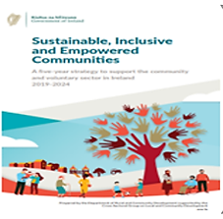

Sustainable, Inclusive and Empowered Communities: a five-year strategy to support the community and voluntary sector in Ireland 2019-2024
Supports partnership and collaborative effort at all levels and between all stakeholders, comprising high level objectives and associated actions to support communities, their representative organisations, and the community and voluntary sector.

Slide 28
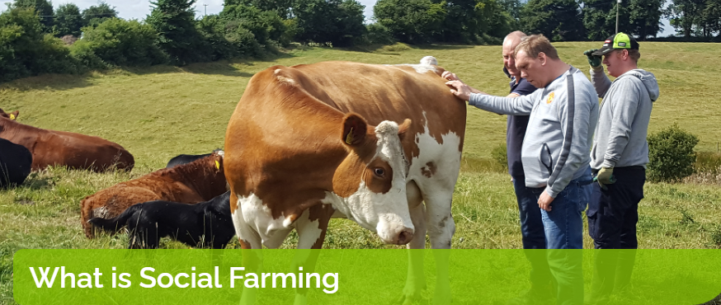
Social Farming offers people who are socially, physically, mentally or intellectually disadvantaged the opportunity to spend time on a family farm in a healthy, safe, supportive and inclusive environment. Encouraging participants to socialise, gain confidence and build relationships.

Slide 29

The National Physical Activity Plan for Ireland
Get Ireland Active, states physical inactivity is a demonstrated clear risk to health and wellbeing and is associated with numerous chronic diseases.
Greenways play a vital part in addressing physical inactivity and provides opportunities for social interaction.

Slide 30

Embracing Ireland’s Outdoors
This National Outdoor Recreation Strategy 2023 – 2027 was developed by Comhairle na Tuaithe (The Countryside Council) in conjunction with the Department of Rural and Community Development.
It will operate in an integrated manner alongside other government strategies and policies including Project Ireland 2040, Our Rural Future and the Future Development of National and Regional Greenways.
It will align with our commitment to the UN Sustainable Development Goals and provides a vision and an overarching framework for the growth and development of outdoor recreation.

Slide 31

Strategy for the Future Development of National and Regional Greenways
Recognises the benefits that can arise from the development of Greenways in terms of economic contributors to rural communities through increased tourism.
They can transform rural areas around the country, provide a wonderful experience for visitors and locals, and contribute to the health of the nation.
The benefits for the health and wellbeing of local communities through the use of Greenways as recreational amenities are significant.

Slide 32

Rural Policy Framework for NI
DAERA vision for rural - Sustainability at the heart of a living, working, active landscape, valued by everyone.
The aim for the Rural Policy Framework for NI is: To create a rural community where people want to live, work and be active in a sustainable and environmentally responsible way.

Slide 33
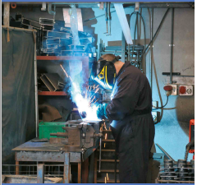
Thematic Pillar 1 – Innovation & Entrepreneurship
To create a rural society where innovation and entrepreneurship flourish
Notes:
This pillar focuses on the ‘people’ aspect (i.e. employees and addressing the barriers to employment)

Slide 34

Key Findings
Wraparound support (animation, training & development, mentoring) & grant aid
Promotion & awareness raising needed for social enterprise model in rural areas
Social interaction & innovation remains important, particularly for young people
Need to focus on micro-enterprise sector
Remote working and digitalisation will likely become more prominent
Notes:
Reduction in commuting will lead to a reduction in carbon emissions
Remote working could lead to improvements in quality of life & health
Appropriate infrastructure can enhance employment & education opportunities, access to rural leisure activities, & increasing population growth in rural areas helping to support sustainability
Population growth projections will put further pressure on limited infrastructure
Quality services need to be available within a reasonable travel time

Slide 35

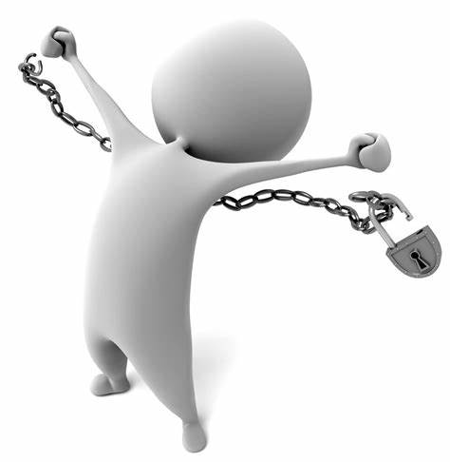

Priority Interventions
Champion: Develop a culture of rural innovation
Empower: Raise awareness, build capacity & capability to engage in rural entrepreneurship & innovation
Enable: Invest in and develop our rural economy

Slide 36
Programme for Government Outcomes
Outcome 1: We prosper through a strong, competitive, regionally balanced economy
Outcome 5: We are an innovative, creative society, where people can fulfil their potential

Slide 37
Thematic Pillar 3 – Health and Wellbeing
To reduce loneliness and social exclusion in rural areas, to minimise the impacts of rural isolation and to promote the health and wellbeing of rural dwellers
Notes:
any policy response should be people centred, putting rural dwellers at the centre of service delivery. Many of the factors affecting the health and wellbeing of rural dwellers are cross-cutting and therefore an integrated strategic approach is required.

Slide 38
Key Findings
Loneliness is not exclusive to one group and impacts across the community.
Groups at particular risk of loneliness and exclusion include, carers (of all ages), young people.
Need to invest in support for community space / infrastructure.
Volunteerism should be encouraged.
Utilise existing rural estate & assets .
Notes:
any policy response should be people centred, putting rural dwellers at the centre of service delivery. Many of the factors affecting the health and wellbeing of rural dwellers are cross-cutting and therefore an integrated strategic approach is required.

Slide 39
Priority Interventions
Champion: Champion awareness and understanding of rural social exclusion, isolation and loneliness
Build Capacity: Support a rural dimension within the work of other organisations which are promoting positive health and wellbeing, addressing social exclusion, isolation and loneliness and build the capacity of rural organisations and people to develop their activities in this area

Slide 40
Priority Interventions Cont.
Reduce: Establish effective approaches to reducing loneliness and social exclusion in rural areas, to minimise the impacts of social isolation and to promote the health and wellbeing of rural dwellers
Sustain: Sustain the future viability of villages as social and economic centres
Community Assets: Support the strategic development of existing rural community assets as places where people can meet, interact, access services and enhance their health and wellbeing

Slide 41
Programme for Government Outcomes
Outcome 3: We have a more equal society
Outcome 4: We enjoy long, health, active lives
Outcome 5: We are an innovative, creative society, where people can fulfil their potential
Outcome 8: We care for others and we help those in need
Outcome 9: We are a shared, welcoming and confident society that respects diversity
Outcome 11: We connect people and opportunities
Outcome 12: We give our children and young people the best start in life

Slide 42
Rural Regeneration and Social Inclusion
Overview of Area 4.2
Lorraine McCourt

Slide 43
Rural Regeneration and Social Inclusion
Specific Objective
“Create a more cohesive society through and an increased provision of shared space and services in rural areas.”
Resulting in:
“Strategic investment to allow rural communities to thrive and reach their full economic, social and environmental potential.”

Slide 44
What does Rural Regeneration and Social Inclusion seek to achieve?
This investment area will support social, economic and environmental projects which contribute to the creation of healthy communities in rural areas.
How?
This will be achieved through health and wellbeing focused solutions, while also tackling social isolation and promoting enhanced social inclusion, creating healthy and inclusive rural communities.

Slide 45
Rural Regeneration and Social Inclusion
What?
The programme will..
Support rural community development, sustainable regeneration and social inclusion through:-
Improved access to key services
Social enterprise development
Development of green infrastructure to improve health and wellbeing
Rural and tourism enterprise.

Slide 46

Budget and Grant Rate
Total Budget available for Investment Area 4.2 is €50 million
(Inclusive of €40 million ERDF and €10 million governmental match funding).
100% of eligible project costs can be sought.

Slide 47
Rural Regeneration and Social Inclusion
Scope and Range
Indicative actions may include:
Community Development Resources: collaborative (cross community and cross border) approaches; key strategic projects and delivery of core community services across rural area boundaries.
Family support Hubs: centralised facilities to support provision of key family support services, ranging from early years to older people in a setting which facilitates increased levels of cross–community contact.
Social Enterprise: Development and delivery of rural specific social enterprise support programmes.

Slide 48
Rural Regeneration and Social Inclusion
Scope and Range
Indicative actions may include:
Green Infrastructure: Development of green infrastructure to promote active lifestyles and support rural enterprise and tourism within rural areas (including those on a cross border basis) and the interconnection of rural and urban areas.
Social Farming: Deployment of resources to support diversification in the agricultural sector and the development of social farms (including collaborative approaches) for social and economic benefit.

Slide 49
Rural Regeneration and Social Inclusion
Who can apply?
Applicants with the capacity to deliver on the outputs, results and actions detailed.
Applicants able to deliver project activities within the eligible area – Northern Ireland and border counties of Ireland
Applicants able to demonstrate ability to deliver cross-border peace and prosperity benefits for rural communities.
Applicants able to develop and implement the project within the project’s lifetime (up to 4 years).
Notes:
There are great opportunities for rural regeneration projects to realise the potential of working with others through cross-border collaboration. This involves signing up to work differently with partners, in a shared process of planning, management and delivery of large scale, strategic cross-border projects, which create a solid infrastructure and build a lasting legacy for future collaboration.

Slide 50
Rural Regeneration and Social Inclusion
Measuring Change
Your project must result in significant and sustained contact between diverse rural communities and as such make a substantial contribution to more peaceful and prosperous rural areas.

Slide 51
Rural Regeneration and Social Inclusion
Indicators
3 Output indicators
Result indicator
20 Jointly developed solutions
65 Enterprises supported
65 Enterprises receiving non-financial support
25,000 Participants accessing new rural facilities, enterprises and community services
Jointly developed – involvement of organisations from at least 2 participating jurisdictions
Notes:
Jointly developed: involvement of organisations from at least 2 participating countries in project design & development.
Enterprises supported: legal unit involved in economic activity (including social enterprise)
Non Financial support – structured support including e.g. advisory services, training, support services (e.g. office support, websites, market research, handbooks, best practice models etc)

Slide 52
PRE-APPLICATION SUPPORT & CONCEPT NOTE
Notes:
I now want to take you through the pre-application support on offer over the coming months.

Slide 53
Prepare and Plan in Advance
Learn early if IA 4.2 is the right area for you / be signposted elsewhere
Opportunity to getting support in advance of the call
Explore and share ideas with potential partners
Tell us about your idea and receive feedback on potential fit with funding criteria
Receive independent advice on how your idea might be strengthened
Notes:
Pre-development support includes:
This is the chance to tell us about your idea and receive feedback;
Receive advice on how your outline idea might be strengthened;
Find out if this is the right investment area for you;
Learn, early on, if Area 4.1 is or is not for you, and be signposted elsewhere;
For those with strong concept notes, we will have one-to-ones to discuss how the project can be further developed.

Slide 54
Rural Regeneration and Social Inclusion
Concept Note (CN)
From today, 15th March 2023, any organisation interested in becoming a Lead Partner under Area 4.2 may complete and submit a Concept Note for comment, advice, and support.
The Concept Note:
covers some (but not all) of the questions that will be in the application-proper;
will help you put in place the foundations of your project so you are better prepared when the call opens;
is not a formal application;
is not scored

Slide 55
Rural Regeneration and Social Inclusion
____________________________________________
HOW TO BUILD A STRONG PROPOSAL
Notes:
For the next ten slides or so, I will focus on the concept note and some of the key questions it asks.
As I said earlier, the concept note does constitute part of the formal application process, although we do envisage that this should be a valuable step in making an application, and – should you choose to proceed – the work you put in at this stage will make for stronger, more robust project built on sound foundations.

Slide 56
Rural Regeneration and Social Inclusion
Concept Note
Short form - 3 pages, with 2 pages of guidance.
Provide high level project details and answer 6 questions, each between 300-500 words.
Advice is available pre- and post-completion.
Please complete and return it no later than 26th April 2023 to: lorraine@lorrainemccourt.com

Slide 57
Rural Regeneration and Social Inclusion
Concept Note: Question 3 (i)
About Your Project
How has need been identified for your project?
How does your project align with what PEACEPLUS, and in particular Area 4.2, is trying to achieve?
To note, supported projects should:
Deliver significant and sustained contact between diverse rural communities
Create a more cohesive society
Enable rural communities to thrive and reach their full economic, social and environmental potential.

Slide 58
Rural Regeneration and Social Inclusion
Concept Note: Question 3 (i) contd.
About Your Project
The extent to which your project has been informed by and / or aligns with best practice e.g.
  How does your project use available knowledge / build on best practice within the sector?
  What’s new or innovative about your project?
  How does your project contribute to EU / National / Regional strategy objectives?

Slide 59
Rural Regeneration and Social Inclusion
Concept Note: Question 3 (ii)
Outputs and Results
How many participants will be engaged in your project?
  IA 4.2 result indicator is for 25,000 participants accessing new rural facilities, enterprises and community services.
How many enterprises will be supported?
  IA 4.2 output indicator is for 65 enterprises to be supported.
How many enterprises will receive non-financial support?
  IA 4.2 output indicator is for 65 enterprises to be supported.
How will your project result in a jointly developed solution?
  IA 4.2 output indicator is for 20 jointly developed solutions.
  Your project’s targets will contribute to these result and output indicators.

Slide 60
Rural Regeneration and Social Inclusion
Concept Note: Question 3 (iii)
Cross Community and Cross Border
How will your proposed project:
  Make a direct contribution to peace and prosperity?
  Lead to increased and sustained cross community interaction?
What geographical area/s will your project cover?
How your project is cross-border on the basis of:
  Using cross border partnerships
  Developing / delivering cross border facilities, services, enterprises and / or activities?

Slide 61
Rural Regeneration and Social Inclusion
Concept Note: Question 3 (iv)
Proposed Team, Partnership, and Implementing Arrangements
Staffing – who is doing what?
Suitable capacity, experience and qualifications?
Practical arrangements for implementation?
Rationale for partnership composition – tried and tested?
Structure of partnership
Risk considered and minimised for project implementation?
Notes:
Staffing: Tell us about the project team, how many and how is doing what?
How are they suitably qualified and experienced to deliver on this project?
What practical arrangements do you have in place to support smooth project implementation?
What is the rationale of the partnership composition and how do the partners complement each other?
Describe the structure of your partnership and why the stated partners are needed to implement the project and to achieve the project objectives.
Project team: how many, and who is doing what?
Their qualifications and experience to deliver on the project?
Practical arrangements to support smooth project implementation?
Management arrangements (project organisation chart)
Is it a tested partnership?
Are all appropriate policies and procedures, incl. safeguarding, up to date and suitable?
Are you financially secure with sufficient cash flow in place to be reimbursed expenditure in arrears?

Slide 62
Rural Regeneration and Social Inclusion
Concept Note: Question 3 (v)
Value for Money
Is it appropriately costed?
Does the estimated budget / resource list cover all required cost areas?
Competitive tender where appropriate?
Will inputs achieve the required outputs and results and meet overall objective?
Exit strategy and durability of results - how is the long-term impact of the project to be secured / sustained?
Notes:
Question 5 is all about VfM
CN asks you to provide a high-level budget.
We will assess the extent to which it is coherent and proportionate?
By time of application, financial allocation per budget line must be in line with the work plan.
Consider and describe your project’s:
Economy Measures: Show the project is appropriately costed, for example, staff positions advertised at the appropriate grade, competitive tendering processes applied, etc. Please use this section to provide detail on the budget requested, the assumptions applied, and how it demonstrates economical use of public resources.
Efficiency and Effectiveness Measures: Use this section to rationalise the inputs for your project in terms of how well they will deliver the stated outputs, results and overall objective of the project.
Exit Strategy: Provide detail on the exit strategy for this project, including evidence of the durability of the outputs and results of the project (i.e., the long-lasting effect of the achievements beyond the duration of the project activity). Please outline the strategy proposed to secure the long-term impact of the project (e.g., mainstreaming / sustaining the project / rolling out of results).

Slide 63
Rural Regeneration and Social Inclusion
Lead Partner Role
Coordination
Financial management
Reporting
Communication
Training
Policies & Procedures
In short, accepts overall responsibility for ensuring implementation of entire project
Notes:
I want to take a moment to underline the extent of the Lead Partner Responsibilities.
A Lead Partner will be an organisation who can handle the governance associated with a project of this size and value and can manage the outputs and results for the beneficiaries concerned.
In order to do that, they will be responsible for:
Coordination – submit application; assume responsibility for smooth implementation of entire project; coordinate all partners and activities.
Financial management – ensures budget control, eligible and timely claims, sufficient cashflow, fund allocation to partners, accepts risk in the event of ineligibility and/or failure to meet targets
Reporting – Coordinates record keeping, oversees monitoring and evaluation, maintains records, ensures timely progress.
Communication – with partners, point of contact with SEUPB and with any other support that is put in place during implementation (for example, liaising with consultant appointed to assist with evaluation)
Training – rolling out any training, be it technical or related to the programme being delivered.
Policies & Procedures – safeguarding, reliable systems, staff support.
In short, the LP accepts overall responsibility for ensuring implementation of entire project, it is significant role.

Slide 64
Other things to bear in mind
Take this time to build your partnership and delivery plan:
  be clear on who is doing what
  build a framework for project management, communications and monitoring & evaluation.
Don’t bite off more than you can chew: can you really deliver on this scale?
Think about finance: can you manage the cash flows?
Have clarity of purpose: your project must always consider its focus on building peace and prosperity for the region.
Notes:
Take this time to build your partnership: be clear on who is doing what; build a framework for communications;
Speak to other potential applicants: try not to cover the same patch; continue to learn from each other and share best practice.
Don’t bite off more than you can chew: can you really deliver on this scale, or might a project partner role or a small grants be better for you?
Think about finance: can you manage the cash flows required for projects of this size?
Have clarity of purpose: but it must have a laser-sharp focus on peace-building and good relations.
Think about how you are going to monitor your targets.

Slide 65

TIMESCALES

Slide 66
What next?
Further support
Feedback
Concept Note
Pre-Development Support
Further support will depend upon both the fit and quality of what is outlined in the concept note.
Aim to provide feedback within 15 working days.
Downloadable from website – complete and return as soon as you can (26th April 2023).
Now available for Area 4.2 of the PEACEPLUS Programme.
Any Questions:
lorraine@lorrainemccourt.com
Notes:
Pre-Development Support: Now available for Area 4.2, Rural Regeneration and Social Inclusion
Concept Note: Downloadable from website – complete and return as soon as you can – please come in sooner if you can as you will get faster feedback.
Feedback: You’ll receive comments within 15 working days.
Support: Further support will depend upon both the fit and quality of what is outlined in the concept note
Any Questions: drop me an email

Slide 67
Rural Regeneration and Social Inclusion
Feedback will aim to identify:
Areas of mis-alignment to funding criteria for IA 4.2
Any lack of clarity in the proposal
Elements which may present a challenge to positive grant assessment;
Recommendations for areas where the quality of project proposals could be strengthened;
Any other issues the applicant should consider in relation to the development and delivery of the project.
Please note: Comments offered are independent and do not represent a guarantee of positive grant outcome. You can choose to accept advice or reject it – project proposals are yours to define.

Slide 68
In Due Course…..
In due course, the following documents will be made available and should be consulted before completing the formal application form:
PEACEPLUS Cooperation Programme
The Programme Manual
Guide for Applicants
Call for Applications to Area 4.2
The Programme Overview is available
Notes:
In due course, call documents, programme rules, and a guide for applicants will all be made available.
These will be issued once the Cooperation Programme has been signed off. All should be consulted before completing the formal application form.
In the meantime, the Programme Overview is available on the SEUPB website.

Slide 69

Questions?

Slide 70
Thanks for listening

