Slide 1
Investment Area 5.1 Biodiversity, Nature Recovery and Resilience
PEACEPLUS Programme

Slide 2
Workshop Overview
Welcome & Housekeeping | Bethany Waterhouse-Bradley - SEUPB
Overview of the PEACEPLUS Programme | Declan McGarrigle, Director of PEACEPLUS Development - SEUPB
Overview of Policy Interests – Ireland | Andy Bleasdale - NPWS
Overview of Policy Interests – Northern Ireland | Jeannine McCool - NIEA, DAERA
Questions and Answers
Overview of IA 5.1, Pre-application Support The Concept Note | Fergal O’Donnell – Insight Solutions
Questions and Answers
Networking Opportunities

Slide 3
The PEACEPLUS Programme
Declan McGarrigle
Director of PEACEPLUS Development
SEUPB

Slide 4
How did we get here?
Support of the NI Executive, the Government of Ireland, the UK Government and the European Union.
Building upon previous PEACE & INTERREG programmes.
Renewed focus on peace and reconciliation.
Ensuring all projects contribute to cross-border and economic and territorial development.
The Peace Bridge Derry-Londonderry

Slide 5
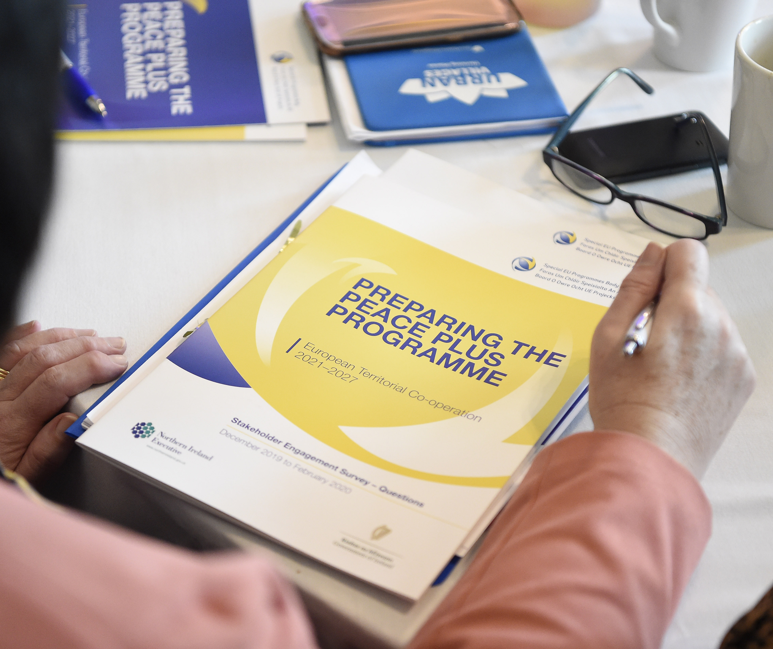
How was PEACEPLUS Developed?
Intensive review, research and public engagement
Stakeholder engagement
Public events – including specific events with young people
Survey submissions
Public consultation (2021)
Bi-laterals with government north-south (ongoing)

Slide 6
PEACEPLUS 2021-2027
Programme area: Northern Ireland and the border counties of Ireland
Programme value: €1.144bn
Six themes, 22 investment areas
Participation from partners outside the area

Slide 7
PROGRAMME OVERVIEW: Where does Biodiversity, Nature Recovery and Resilience fit in?
Theme 1
Building Peaceful and Thriving Communities
€250m
Theme 2
Delivering Socio- Economic Regeneration & Transformation
€170m
Theme 3
Empowering and Investing in Our Young People
€123m
Theme 4
Healthy and Inclusive Communities
€172m
Theme 5
Supporting a Sustainable Future
€303m
Theme 6
Building and Embedding Partnership and Collaboration
€52m
Thematic Areas
1.1 Co-designed Local Community Peace Action Plans
1.2 Empowering Communities
1.3 Building Positive Relations
1.4 Reimaging Communities
2.1 Programme Area SME Development and Transition
2.2 Programme Area Innovation Challenge Fund
2.3 Programme Area Skills Programme
2.4 Smart Cities, Towns and Villages
3.1 Shared Learning Together Education Programme
3.2 PEACEPLUS Youth Programme
3.3 Youth Mental Health
4.1 Collaborative Health and Social Care
4.2 Rural Development and Regeneration
4.3 Victims and Survivors
5.1 Biodiversity, Nature Recovery and Resilience
5.2 Marine and Coastal Management
5.3 Water Quality and Catchment Management
5.4 Water Quality Improvement Programme
5.5 Geothermal
5.6 Transport
6.1 Strategic Planning
6.2 Maintaining and Forging Relationships between Citizens
Investment Areas

Slide 8
The Project Lifecycle
PREDEVELOPMENT
Elaboration of project idea, concept note, partner search
Call
PROJECT DEVELOPMENT AND APPLICATION
PROJECT CLOSURE
Project assessment and selection
Strategy and content, responsibilities, application requirements
Final reporting, post-project activities, use of results
Modification assessment and selection.
Monitoring achievement
PROJECT IMPLEMENTATION
Letter of Offer, Partnership Agreement, kick off, detailed planning, conditions
CONTRACTING AND START-UP
Coordination of activities, reporting, monitoring, modifications, evaluation, financial management, communication
Notes:
Pink diamonds: Some key points where programme committees have a role in.
All projects, regardless of the type (from previous slide) have the same project lifecycle

Slide 9
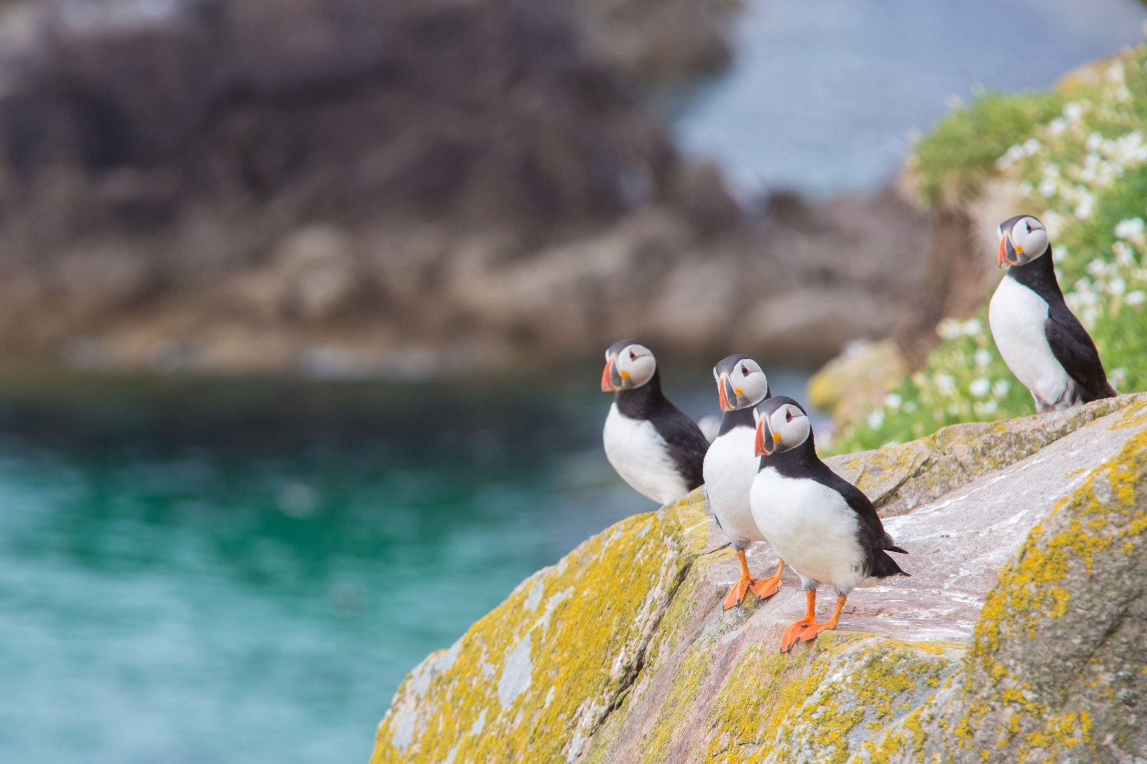
Biodiversity, Nature Recovery and Resilience
Overview of Investment Area 5.1

Slide 10
Theme 5: Building a Sustainable and Better Connected Future
At the forefront of the previous INTERREG Programme
Creating places where people want to live, visit and invest
Sustainability that works for everyone – contributing to a thriving environment where businesses and people can flourish

Slide 11
PEACEPLUS – Environment Programme
Theme 5: Supporting a Sustainable and Better Connected Future
5.1 Biodiversity, Nature Recovery and Resilience
5.2 Marine and Coastal Management
5.3 Water Quality and Catchment Management
5.4 Water Quality Improvement Programme
5.5 Geothermal Energy Demonstration Programme
5.6 Enhanced Sustainable Travel Connectivity

Slide 12
5.1 Objectives and Results
This objective will promote enhanced protection and preservation of nature, biodiversity and green infrastructure, including in urban areas, and reduction in all forms of pollution. It will promote cross-border co-operation to facilitate the recovery of selected habitats and species across the Programme Area. It presents an opportunity to build upon current INTERREG VA Programme by continuing to promote cross border co-operation and facilitating the recovery of additional protected habitats and priority species.
It will result in an increase in the surface area of selected habitats and habitats for species in improving conditions that create a more cohesive society through an increased provision of community spaces, key services and supports in rural areas.

Slide 13
5.1 seeks to deliver improved and restored habitats through:
Increased defence against threats from invasive alien species
Enhanced resilience to climate change, nature-based solutions to mitigation and adaptation
Contribution to legal obligations and policy targets relating to favourable conservation status
Nature-based solutions to wildfire risk management, flood protection, carbon storage and climate buffers
Establishing Nature Recovery Networks, improving public engagement and access to nature
Restoration of peatland/wetland sites – carbon sinks for net zero targets

Slide 14
5.1: Output and Result Indicators
Output Indicator | Measurement Unit | Target Value
Surface of Natura 2000 sites covered by protection and restoration measures | Hectares (Ha) | 11,184 Ha
Green infrastructure supported for other purposes than adaptation to climate change | Hectares (Ha) | 5,300 Ha
Strategies and action plans jointly developed | Strategy/action plan | 1
Result Indicator | Measurement Unit | Target Value
Number of management units demonstrating a positive change in condition | Management Units | 50
Joint strategies and action plans taken up by organization | Joint strategy/action plan | 1

Slide 15
Policy Interests: Ireland
Andy Bleasdale,
NPWS

Slide 16
Ireland (NPWS) policy priorities for PEACEPLUS
Andy Bleasdale
29th March 2023

Slide 17
Habitats and Species INTERREG VA
N2K Habitats:
Blanket Bog
Transition mires
Active Raised Bog
Marl lakes
Alkaline Fens
Calcareous fens
Petrifying springs
N2K Species:
Hen Harrier
Marsh Fritillary
White-clawed Crayfish
Breeding waders
Curlew
Lapwing
Redshank
Snipe

Slide 18
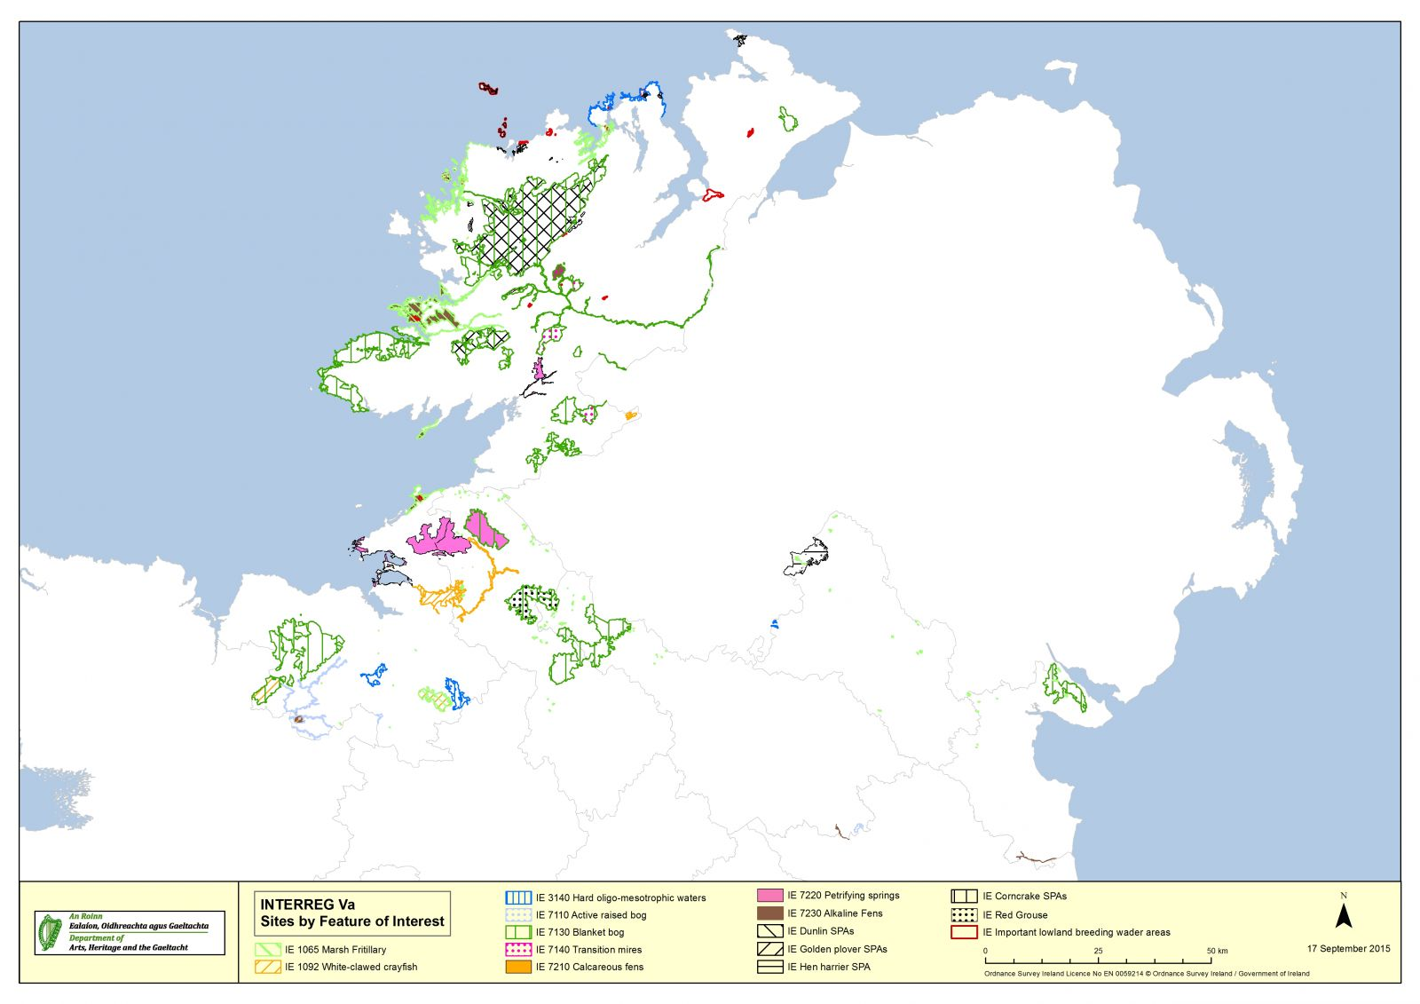

Slide 19
Pressing Conservation Needs for Ireland
Strengthening knowledge base
Improved delivery mechanisms
Building necessary community buy-in
Informed Action
Building capacity through doing
Coherence across jurisdictions, programmes and work packages
Alignment with other PEACEPLUS priorities and projects
Supporting national/jurisdictional priorities

Slide 20
Common Needs across our borders
Protected site restoration:
Delivery of necessary conservation measures in line with the SSCOs in selected sites (SACs, SPAs and NHAs) to support the achievement of improved conservation condition for listed habitats and species
Contribute to an increase in ecological and climate resilience at site level
Build on actions already delivered through the INTERREG VA via CANN and CABB

Slide 21
Common Needs across our borders
Nature recovery networks and nature-based projects:
The identification of key areas for nature recovery and the development and implementation of ecological recovery networks, encompassing
green infrastructure
monitoring of species to determine necessary conservation action and
the identification and implementation of nature-based solutions to address biodiversity loss and to support climate mitigation and adaption

Slide 22
Common Needs across our borders
Cross border initiatives to address invasive alien species (IAS):
Contribution to an all-island strategy and action plan on invasive alien species to be developed through Shared Island funding including:
Working with government partners (NPWS and NIEA) on invasive species and biosecurity
Supporting the development of an all-island expert assessment body
Developing phased catchment-level invasive species action plans in identified areas
Implementing initial phases of invasive species action plans

Slide 23
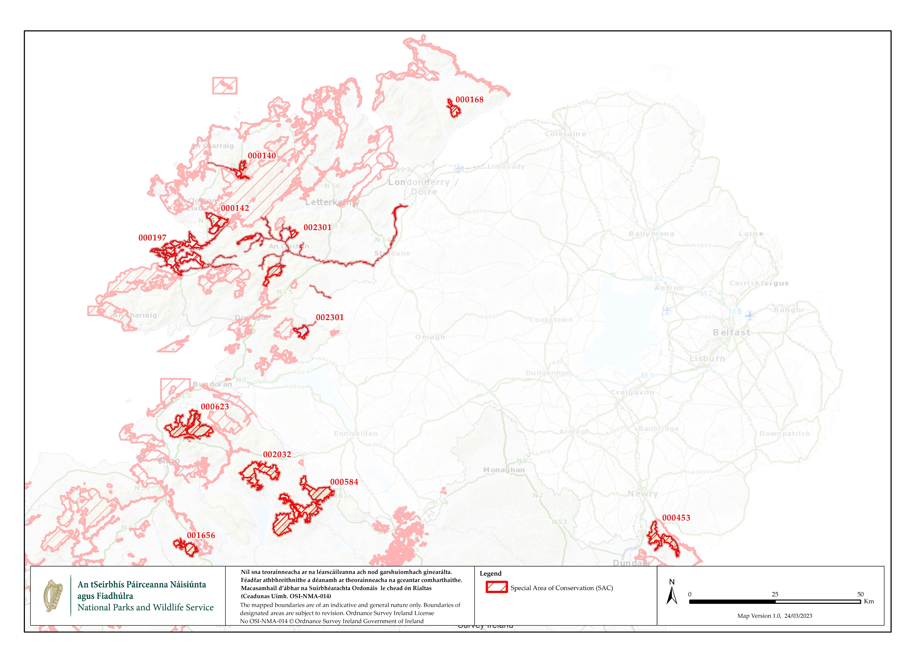

Slide 24
Priority SACs in the border counties

Slide 25
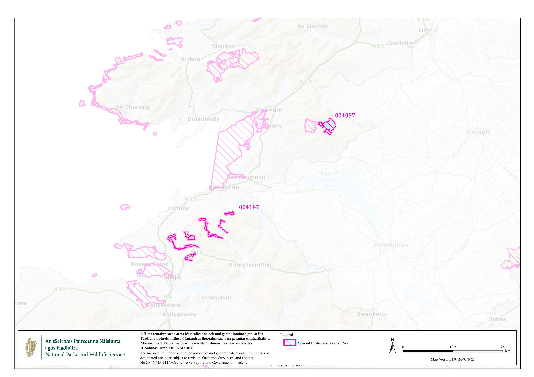

Slide 26
Priority SPAs in the border counties

Slide 27
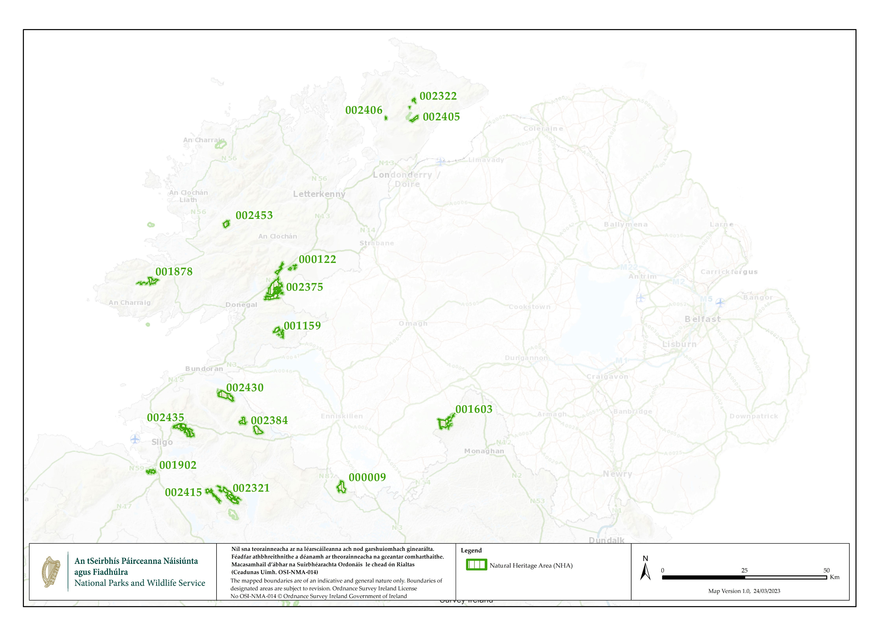

Slide 28
Priority NHAs in the border counties

Slide 29
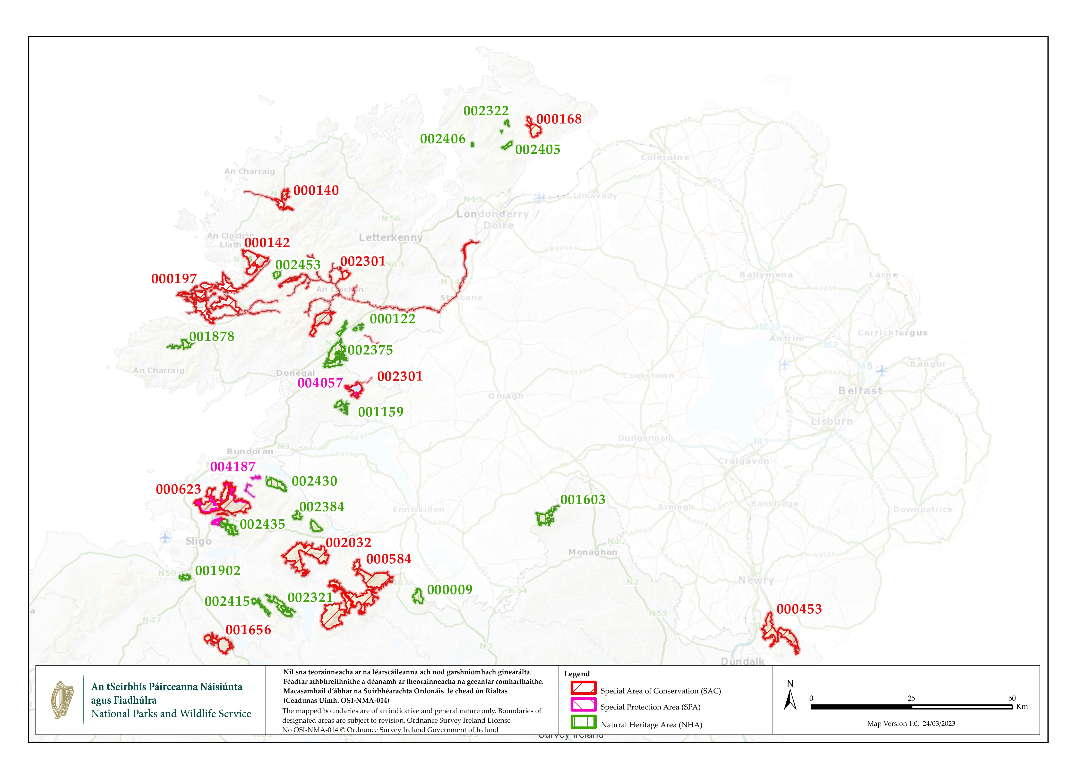

Slide 30
Information in NPWS (npws.ie or by request)
Lists of Sites (by Feature of Interest)
Site Information (Site Synopses, Statutory Instruments, Qualifying Interests, Standard Data Forms)
Site Specific Conservation Objectives (SSCOs) for sites
Maps of Feature of Interest (GIS-ESRI Shapefiles)
Article 17 & Article 12 data

Slide 31
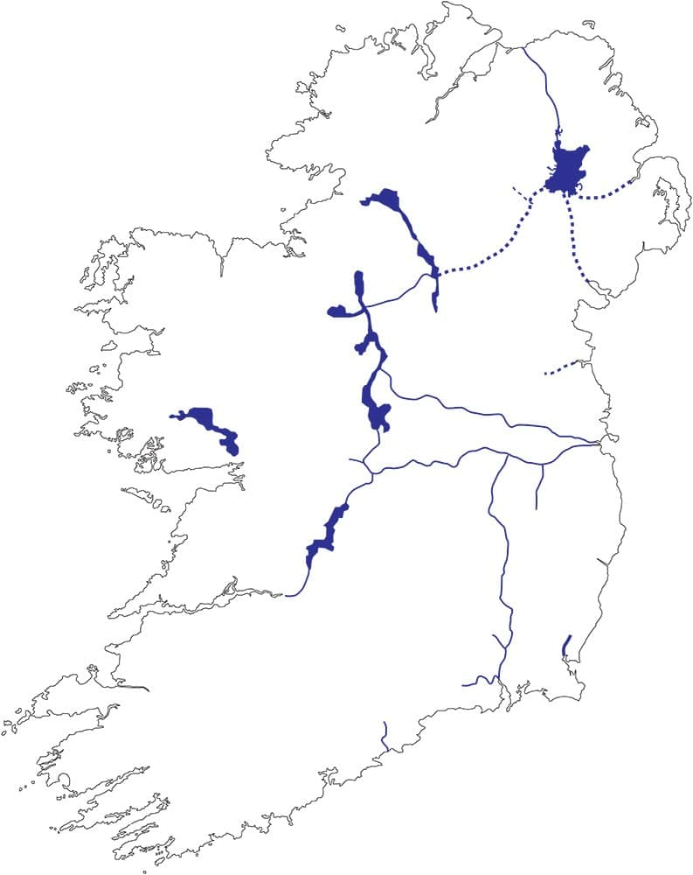
The Shared Island Invasive Species & Biosecurity Initiative
Once established, Invasive alien species (IAS) disperse naturally through catchments, waterways, overland and by human activity.
Being an island affords good potential to reduce the risk of
further introductions.
Cooperation and coordination on a Shared Island basis is needed to reduce the risk of further spread and impact from existing invasions in Ireland.
Precedent for a successful cross-border approach was the internationally recognized successful framework of the Invasive Species Ireland Initiative 2007 to 2013.
Ireland’s Waterways – connecting catchments via canals
Working together is better!
www.iwai.ie
Notes:
Invasive species would not naturally occur in Ireland but are here because of human activity (intentional and unintentional).
When introduced, they survive and thrive to the point of negatively impacting on our wildlife, on the services nature provides, on our economy, and the way we live.
However, once they arrive and establish, dispersal through catchments, overland via transport corridors etc is inevitable.
Being an island, brings good potential to implement measures to reduce the risk of introduction.
A shared l island with a shared common threat requires a strategic and partnership approach to a shared response.
By taking a Shared Island approach benefit include to be had by tackling the threat through a shared island approach.
Shared Island. Shared threats. Shared opportunities through partnership to collectively agree a positive framework to address the problem
Shared Island initiative ensures harmonization on approach, aims, standards, methodologies etc.

Slide 32
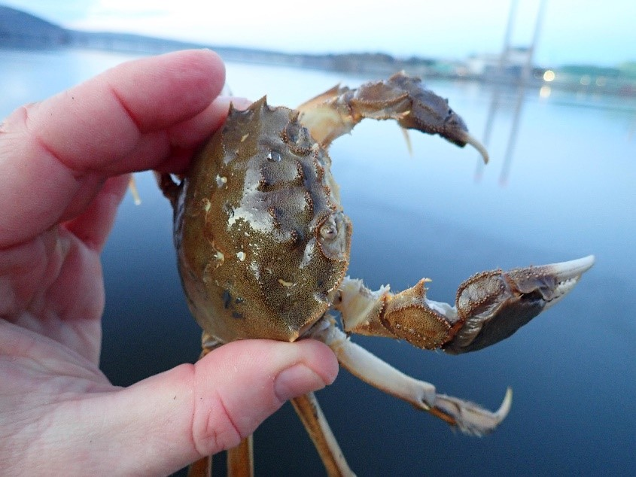
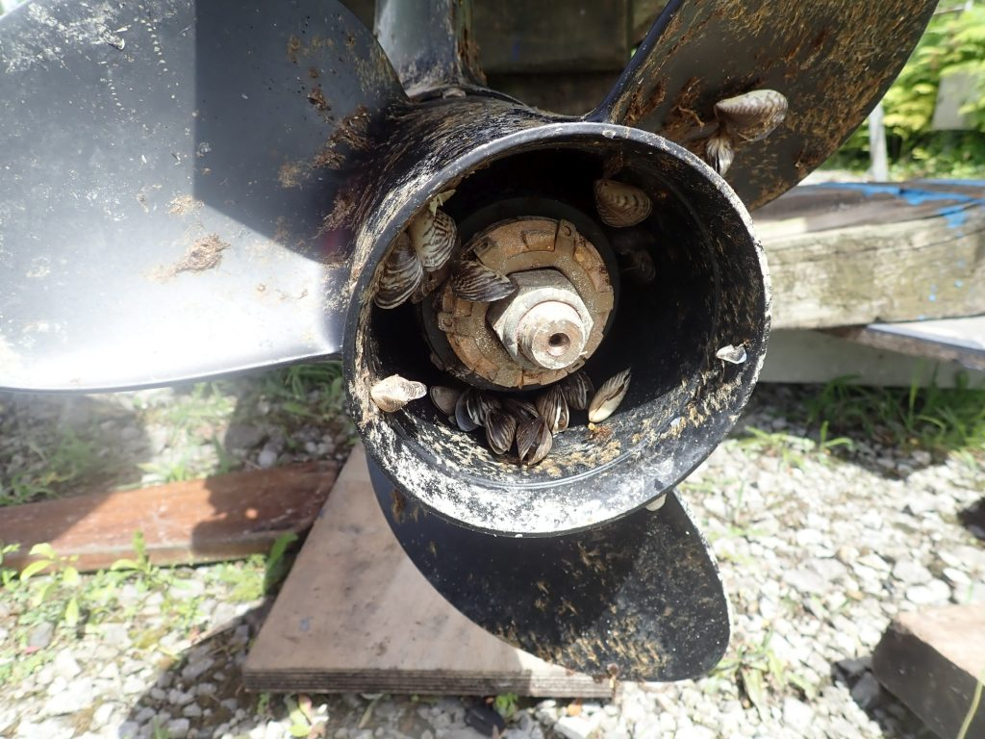
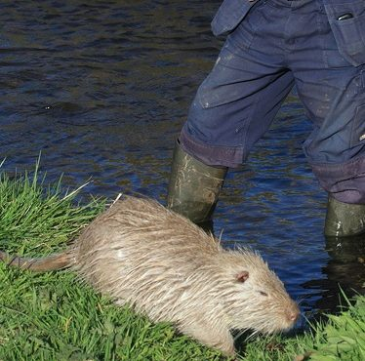
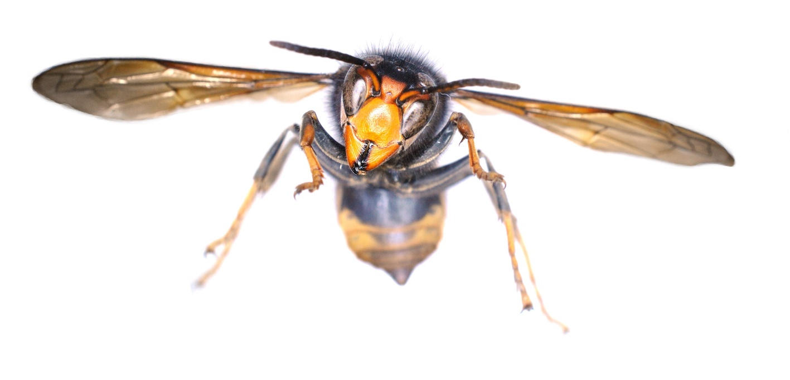
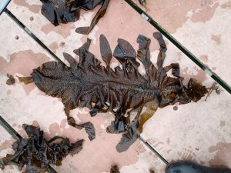
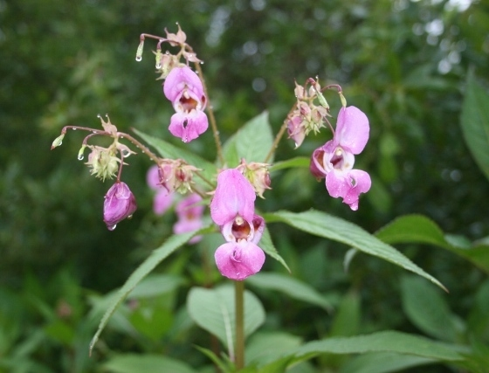
Quagga mussel
Coypu
Chinese mitten crab
Chinese mitten
Asian hornet
Wakame
Himalayan balsam

Slide 33
The Initiative
Stemming from the Shared Island session at the NPWS Biodiversity Conference in Dublin May 2022, a proposal was submitted to the Department of the Taoiseach's Shared Island Unit. The proposal sets out 7 overarching deliverables
Strategic all-island risk assessment and trend analysis will be undertaken to inform decision making to prioritise mitigating actions including regulated listing of species. It will incorporate analysis of compounding impact on people and nature from climate change and invasive alien species.
A Biosecurity and Implementation Strategy to address border biosecurity. This will strategically aim to reduce the risk of introduction of invasive alien species to the island of Ireland at key border entry points and will also address key North-South border risks.
Catchment level aquatic management measures are coordinated across key cross border catchments/regions. This will provide coordinated action both sides of the border for these areas.
Notes:
This Shared Island Invasive Species and Biosecurity Initiative will prioritize areas of cooperation that are mutually beneficial to support decision making on mitigating actions. It will build from rigorous assessment processes to prioritize actions for biosecurity, contingency, and pathway planning. It will provide information to support coordinated action for select cross-border regions, roll-out a well-structured outreach plan to engage citizen scientists and, deliver a bi-annual invasive species conference.

Slide 34
The Initiative
Shared Island Contingency Plans. Contingency plans for development will be prioritized based on a matrix of factors including horizon scan exercises and risk assessment of IAS of Union concern.
Shared Island Pathway Action Plans and alignment of existing Pathway Action Plans. Strategic and resource benefit will be gained from aligning existing pathway action plans and developing future plans on a Shared Island basis. This would ensure coordinated implementation planning supported by regular stakeholder engagement.
A Citizen Science Invasive Species Programme. This will contribute to official early detection and monitoring networks through delivery of identification and recording workshops, biosecurity workshops, enhancing existing recording networks and producing and facilitating availability of information for volunteer management projects.
Three Shared Island Invasive Species Conferences

Slide 35
Governance & Added Value
Funding was announced and approved in December 2022
To be led by the NBDC and the NIEA and overseen by a Steering Group
The Initiative will contribute directly to implementation of the investment objective in the Shared Island chapter of the revised NDP on “Supporting more all-island approaches to biodiversity protection”
The Initiative not only ensures joined-up strategies and coordination - which is a sensible approach - but also reduces the burden of cost to each administration
The Initiative will also support the development and implementation of catchment-level IAS action plans at site/project level through the PEACEPLUS programme
Notes:
NPWS will provide updates on the project to Department of the Taoiseach’s Shared Island unit on progress of the project.

Slide 36
Lessons learned
The projects involve hard work for all involved, so the investment of time by you and the competent authorities has to be worth it
Data and ecological management and coherence between WPs is critical; ecological, data and GIS leads are required to manage across work packages and to ensure coherent engagement with NPWS and NIEA
Work closely with other projects and programmes (such as other PEACEPLUS projects, Wild Atlantic Nature, WaterLANDS, Cooperation projects and European Innovation Partnership projects) to ensure consistency of approaches for common tasks, to build capacity and avoid overlaps.

Slide 37
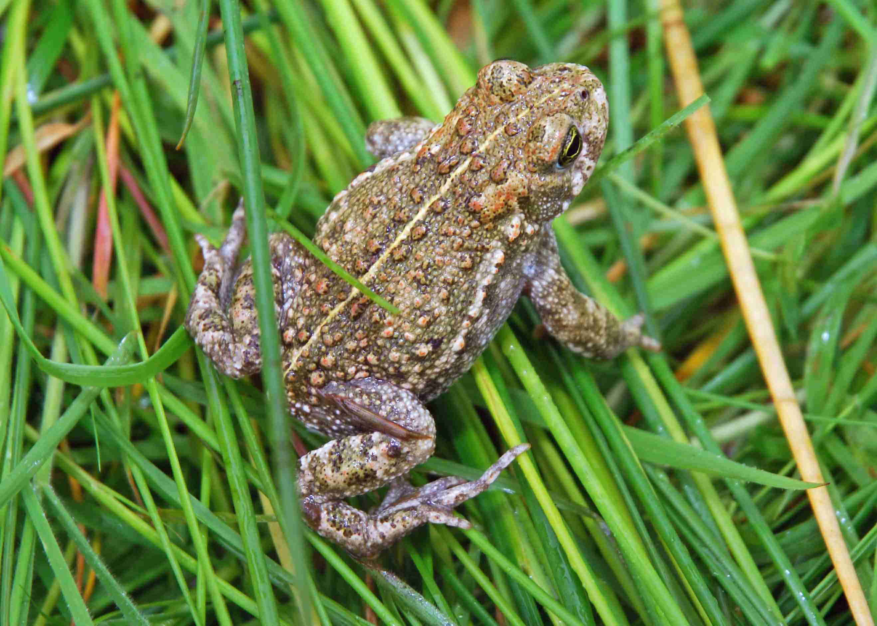
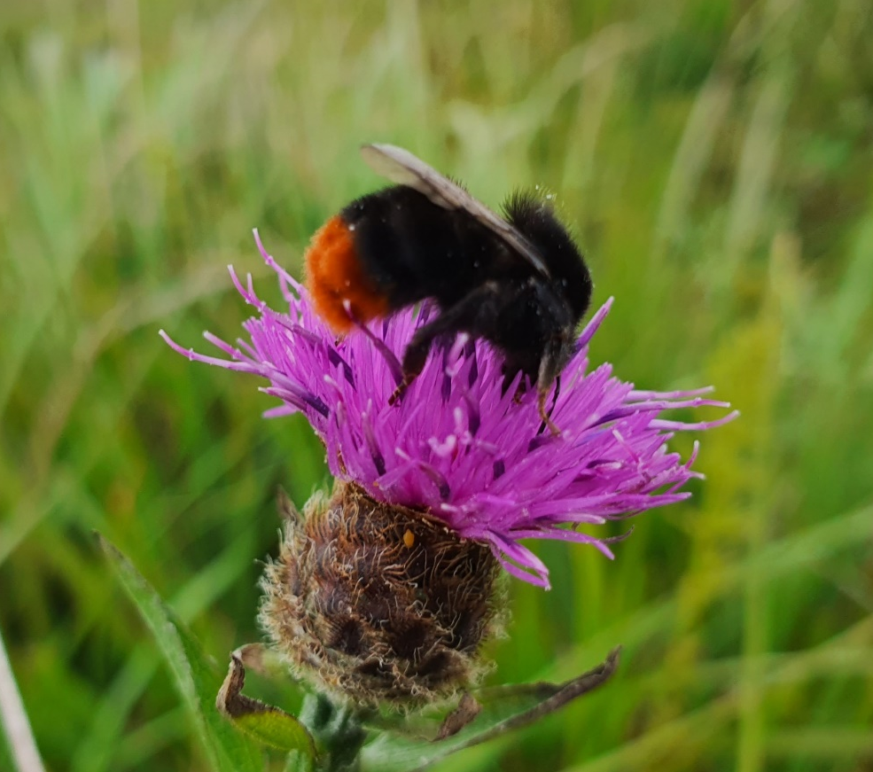
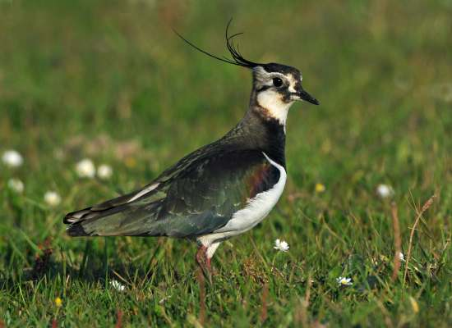
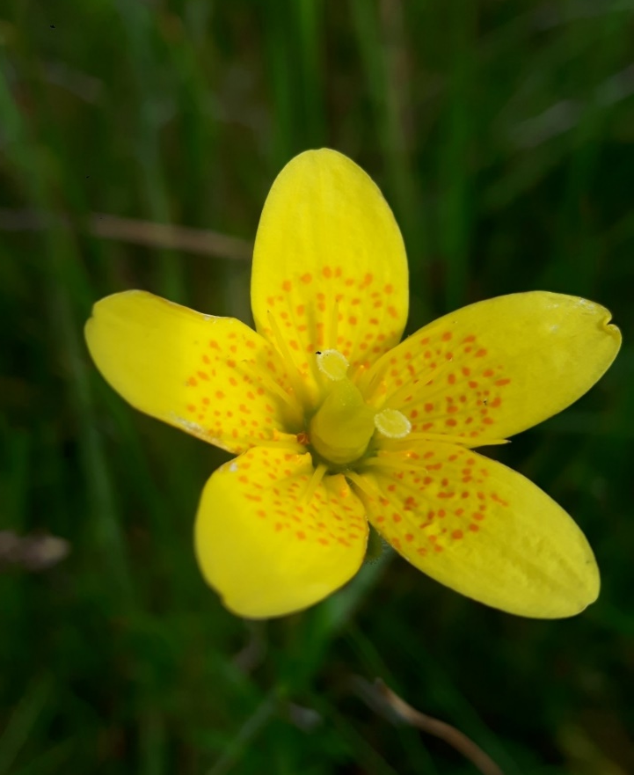
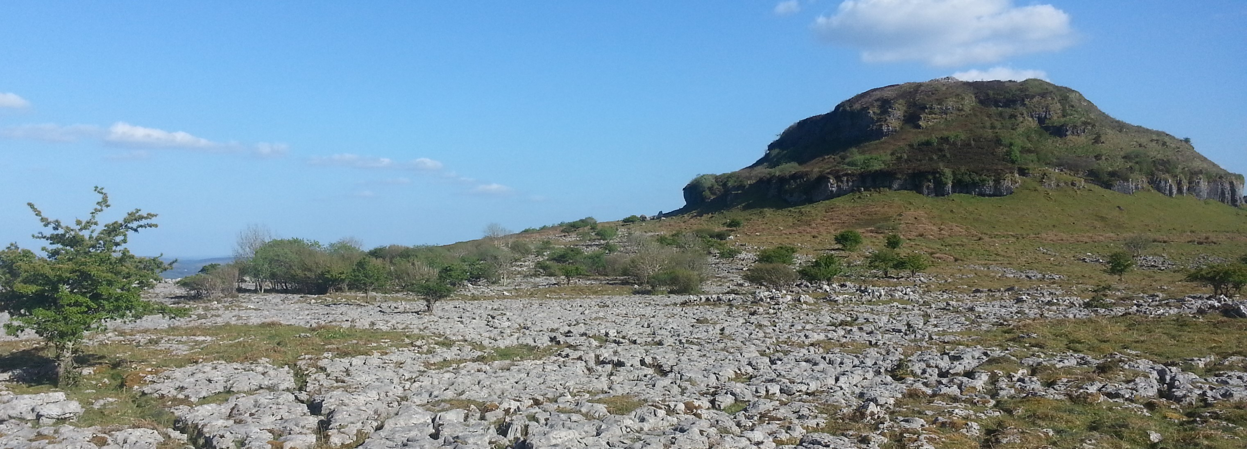
Thanks for listening –
good luck with the next steps

Slide 38
Policy Interests: Northern Ireland
Jeannine McCool,
NIEA - DAERA

Slide 39
Environmental Priorities for DAERA Jeannine McCool

Slide 40
International Conventions / Multilateral Environmental Agreements (MEAS)
Notes:
The Department has a vast number of International Conventions and Multilateral Environmental Agreements which drive our priorities.

Slide 41
PfG Outcomes Framework
DAERA is responsible for outcome two but has a role to play in several outcomes
Notes:
However DAERA also has a role to play in cross departmental delivery of the following outcomes:
4) We enjoy long, healthy active lives
5) Everyone can reach their potential
6) Our economy is globally competitive, regionally balanced and carbon-neutral
9) People want to live, work and visit here

Slide 42
NI Biodiversity Policy Development
Global Biodiversity Framework
UK Biodiversity Framework
NI Biodiversity Strategy
Relevant policies and strategies
Environment Strategy Peatland Strategy Climate Action Plan Clean Air Strategy Green Growth Strategy Planning policy | Ammonia Strategy Fisheries Policy Food Strategy Agricultural Policy Nutrient Action Programme Circular Economy

Slide 43
NI Priorities for PEACEPLUS Investment

Slide 44
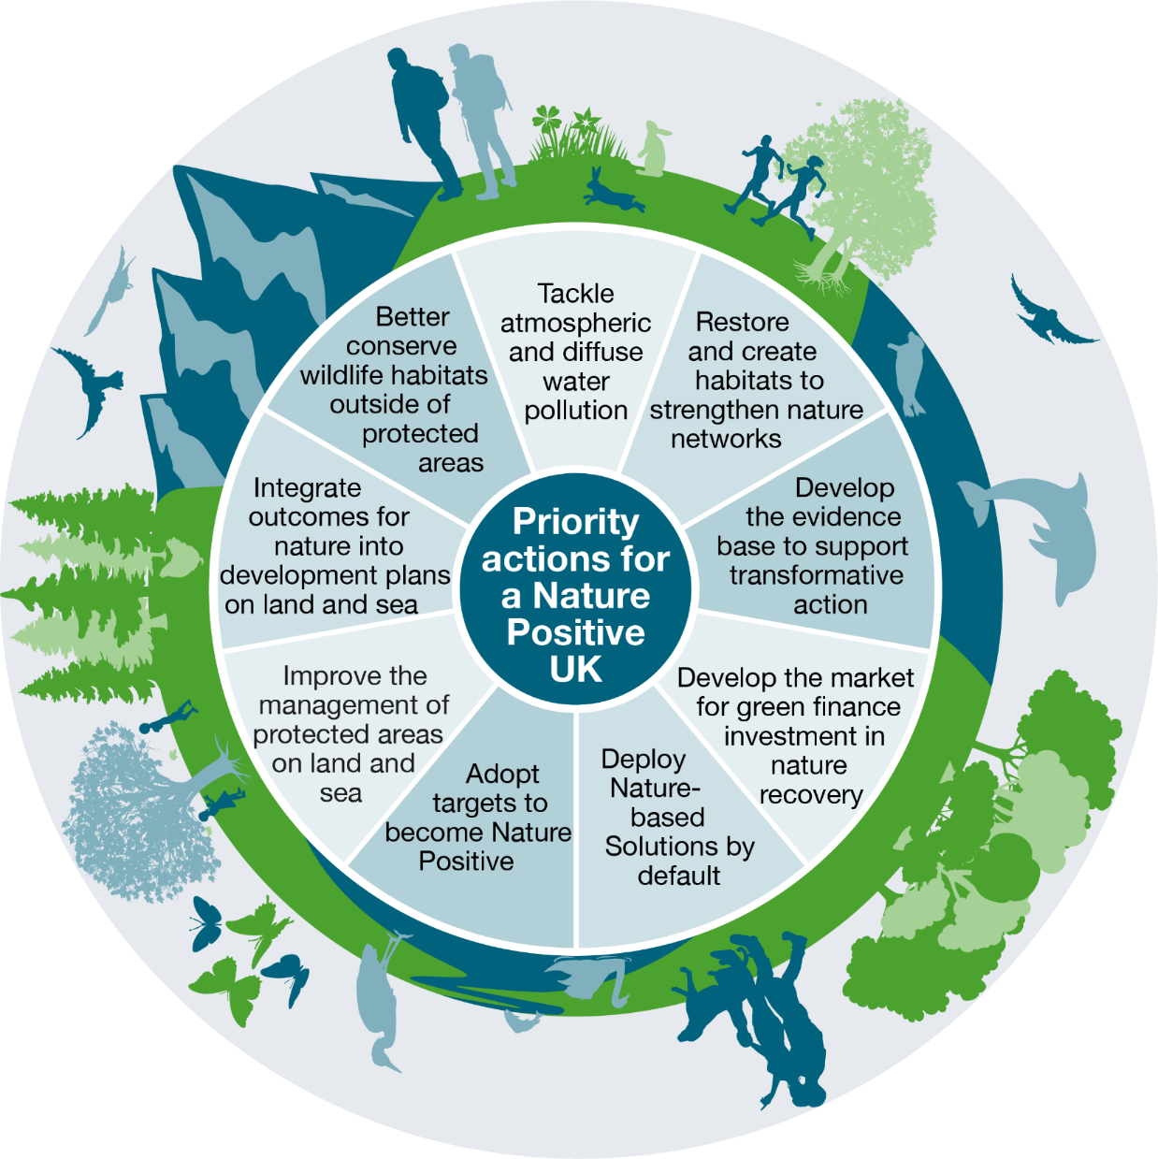
Priority Actions for a Nature Positive NI
UK SNCB Nature Positive 2030 Report, 2021
Biodiversity: Protection – Restoration - Mainstreaming
Notes:
Biodiversity: Protection – Restoration - Mainstreaming
Spatial planning – protecting, enhancing, connecting important areas for biodiversity, nature positive
Spatial prioritisation – nature recovery, 30x30, nature-based solutions
Strengthening protections – priority habitats, species, ecosystems
Targeted conservation action – sites, species, NRNs, NbS
Strategic approach for drivers of biodiversity loss, e.g. ammonia

Slide 45
NI’s Priorities for PEACEPLUS
Improved and restored habitats and species within protected sites and more resilient ecosystems in the wider landscape
Significant contribution to meeting legally binding requirements and Programme for Government targets to put in place the necessary conservation measures and achieve favourable conservation status for selected habitats and species
Enhanced resilience to the effects of climate change and ability to deliver vital nature-based solutions for climate change mitigation and adaptation
Protected Sites Restoration
Deliver conservation measures for targeted habitats and species to complement Special Areas of Conservation (SAC) core sites through expansion into Special Protection Areas (SPAs), Areas of Special Scientific Interest (ASSIs) and suitable supporting habitats outside protected areas identified as being important to the hydrological and ecological function, and/or ecological connectivity of the resource.
Notes:
The desires outcomes are available on the SEUPB website the main priorities for NI are:

Slide 46
NI’s Priorities continued
Target the remaining Northern Ireland network of peatland and wetland SACs as core sites for biodiversity restoration through implementation of SAC CAPs/CMPs to restore hydrological and ecological function and support recovery for all species of scientific interest within the site
See SEUPB Website for targeted habitats and species and associated protected sites
Notes:
IA_5.1_Priority_List_v2.pdf (seupb.eu)

Slide 47
NI’s Priorities continued
Nature Recovery Networks
The identification of key areas for nature recovery and the development and implementation of ecological recovery networks, encompassing:
green infrastructure;
monitoring of species to determine necessary conservation action;
the identification and implementation of nature-based solutions for climate mitigation and adaption
Notes:
There are many definitions of ‘Green Infrastructure’ refer to SEUPB’s definition.
According to the European Environment Agency, Green infrastructure is a strategically planned network of natural and semi-natural areas with other environmental features designed and managed to deliver a wide range of ecosystem services such as water purification, air quality, space for recreation and climate mitigation and adaptation. This network of green (land) and blue (water) spaces can improve environmental conditions and therefore citizens' health and quality of life. It also supports a green economy, creates job opportunities and enhances biodiversity.

Slide 48
NI’s Priorities continued
Initiatives to address invasive alien species
Contribution to an all-island strategy and action plan on invasive alien species including:
Working with government partners on invasive species and biosecurity.
Supporting the development of an all-island expert assessment body.
Developing phased catchment-level invasive species action plans in identified areas.
Implementing initial phases of invasive species action plans.
Notes:
IA_5.1_Priority_List_v2.pdf (seupb.eu)
There are many definitions of ‘Green Infrastructure’

Slide 49
Key Recommendation
Projects should source & maintain a strong ecological scientific lead officer within the project team structure to facilitate specialist advice and guidance on the specific ecological needs throughout the project.
Notes:
The departments role is as an Accountable Department. We are unable to provide significant support in terms of accuracy of habitat mapping, monitoring and reporting. We would request that each proposal seeks to maintain a strong ecological lead throughout the project.

Slide 50
Supporting Information
NIEA can provide the following information:
Copy of the baseline indicators
List of the sites*
For each ASSI - Citation, map, special place leaflet and View About Management (VAM)*
Conservation Objectives*
*Some of this is available on our website
Notes:
We have 47 draft plans with 10 drafts outstanding and unavailable at this time

Slide 51
Supporting Information Cont’d
Most recent condition assessment – report and condition assessment point map
Article 17 reports should be on JNCC website
Raw condition assessment is available on request
Draft Conservation Management Plans for 47 NI SAC’s
Notes:
Please note there are 10 CMP drafts outstanding (not available)
CMP’s
NIEA embarked on a work programme in 2017 to develop Conservation Management Plans for 57 Special Areas of Conservation (SACs), funded through a variety of mechanisms – CANN and CABB (INTERREG VA), Rural Development Fund (RDP), eNGOs via Environment Fund and NIEA site maintenance.
Each CMP defines the site-specific necessary conservation measures, required to move the site features towards favourable condition, therefore providing a framework for conservation action and delivery going forward. The CMPs focus on land management issues impacting the site primarily within the site boundary, as agreed with key stakeholders and landholders.
Other pressures emanating from outside the sites will be highlighted in the CMPs, such as water pollution, wildfire threat and air pollution. However, the conservation actions required to remedy these pressures will need to be set out in more detail through parallel processes, e.g., aligned river basin management plans/programme of measures to address water quality issues.

Slide 52
CMP Data Availability
The following tables detail the sites under PEACEPLUS Investment Area 5.1: Biodiversity, Nature Recovery and Resilience, and the CMP data currently available.
SAC site | CMP report (Word doc. & Excel tables)* | Habitat Map
Aughnadarragh Lough | ✗ | ✗
Black Bog | ✗ | ✗
Eastern Mournes | ✗ | ✓
Moninea Bog | ✓ | ✓
Ballynahone Bog | ✓ | ✓
Cranny Bogs | ✓ | ✓
Cuilcagh Mountain | ✓ | ✓
* CMP Report and Excel tables include background information on the SAC, pressures and threats assessment of the site, stakeholder engagement details and proposed conservation management actions.
Notes:
Slides will be available within 7 days on SEUBP website
Slides 18-21 are a selection of SAC CMPs and info currently available, CMP information for other sites may be available upon request via SEUPB

Slide 53
CMP Data Availability Cont’d
SAC site | CMP report (Word doc. & Excel tables)* | Habitat Map
Curran Bog | ✓ | ✓
Fairy Water Bogs | ✓ | ✓
Garron Plateau | ✓ | ✓
Garry Bog | ✓ | ✓
Lecale Fens | ✓ | ✓
Magheraveely Marl Loughs | ✗ | ✓
Moneygal Bog | ✓ | ✓
Montiaghs Moss | ✓ | ✓
Murlough | ✗ | ✗
* CMP Report and Excel tables include background information on the SAC, pressures and threats assessment of the site, stakeholder engagement details and proposed conservation management actions.

Slide 54
CMP Data Availability Cont’d
SAC site | CMP report (Word doc. & Excel tables)* | Habitat Map
Peatlands Park | ✓ | ✓
Pettigoe Plateau | ✓ | ✓
Slieve Beagh | ✓ | ✓
Tully Bog | ✓ | ✓
Turmennan | ✓ | ✓
Ballykilbeg | ✓ | ✓
Breen Wood | ✓ | ✓
Carn/Glenshane Pass | ✓ | ✓
Dead Island Bog | ✓ | ✓
Deroran Bog | ✓ | ✓
* CMP Report and Excel tables include background information on the SAC, pressures and threats assessment of the site, stakeholder engagement details and proposed conservation management actions.

Slide 55
CMP Data Availability Cont’d
SAC site | CMP report (Word doc. & Excel tables)* | Habitat Map
Derryleckagh | ✓ | ✓
Largalinny | ✓ | ✓
Magilligan | ✓ | ✓
Main Valley Bogs | ✓ | ✓
Monawilkin | ✓ | ✗
Teal Lough | ✓ | ✓
Tonnagh Beg Bog | ✓ | ✓
West Fermanagh Scarplands | ✓ | ✗
Wolf Island Bog | ✓ | ✓
Upper Lough Erne | ✓ | ✗
* CMP Report and Excel tables include background information on the SAC, pressures and threats assessment of the site, stakeholder engagement details and proposed conservation management actions.

Slide 56
Requesting Information Not Publicly Available
CMP’s
Although there are 47 CMPs in draft they are in the final stages of verification and therefore Natural Environment Division are content to furnish groups proposing to develop PEACEPLUS projects with these documents upon request.
Notes:
Please note we will endeavour to satisfy requests for CMP data as fully as possible; verification of CMP data is currently ongoing for a number of sites and therefore some of the data requested may be unavailable.

Slide 57
Requesting Information Not Publicly Available cont’d
Any group requiring information from us to develop PEACEPLUS proposals may do so via SEUPB.
We will endeavour to furnish SEUPB with the requested data request within 20 working days.
Please note Data Sharing Agreements (DSAs) may be required which will require prompt return to release the requested data.

Slide 58
Thank you for listening

Slide 59
Pre-application support and the Concept Note
Fergal O’Donnell,
Insight Solutions

Slide 60
Pre-Application Support
5.1 Biodiversity, Nature Recovery and Resilience
From today, 29th March, any organisation interested in becoming a Lead Partner under Area 5.1 may complete and submit a Concept Note for comment, advice and support.
The Concept Note:
Short form, seeking high level project details
Is not a formal application and is not scored
Covers some (but not all) of the questions that will be in the application proper;
Will help you put in place the foundations of your project so that you are better prepared when the call opens;
Will give an indication if this is the right fund for your project
Avoids putting you through an onerous process if full application not for you.
Notes:
The Peace Programmes Learning Platform is a living archive of the work funded by the EU Peace Programmes over the last three decades.
It showcases the achievements of over 22,500 projects and provides inspiration for the continual integration of communities in post-conflict societies – not just in Northern Ireland but around the world.

Slide 61
Concept Note
5.1 Biodiversity, Nature Recovery and Resilience
Is downloadable from https://seupb.eu/PEACEPLUS
Advice is available pre- and post-completion
Complete and return no later than 10th May 2023
Email to fergal@insight-solutions.org
Written response provided in no less than 15 working days from the date of submission
Meetings arranged to discuss Concept Note feedback
Notes:
Is downloadable from https://seupb.eu/PEACEPLUS
The uncompleted form is short, six pages: three to be completed and three of guidance.
You are invited to provide high level project details and answer six questions, each in up to 300-500 words.
Advice is available pre- and post-completion.
Avoid putting you through an onerous process if not for you
Please complete and return it no later than 10th May 2023 to eimear.bush@seupb.eu

Slide 62
Concept Note, Question 1
Tell us about your project?
In your response you may want to consider;
- How the project aligns with what PEACEPLUS, and in particular Area 5.1, is trying to achieve?
- How the project promotes cross border co-operation to facilitate the recovery of selected habitats and species within the Programme area?
- To what extent will you contribute to the Output and Results Indicators?
- Do the proposed activities contribute to programme priorities?
Notes:
objective will enable a cross-border, collaborative approach to management and improvement of water quality to address the requirements of the Water Framework Directive in selected cross-border catchments located within the Programme Area
It will result in the development and management of cross-border water quality** as well as catchment management programmes, designed to enable freshwater bodies in cross-border river basins to achieve good or high status; and an increased percentage of shared waters in the Programme Area with good or high status.
**Water quality includes water quantity and status

Slide 63
Concept Note, Question 1
Programme Priorities
Increase defence against threats from invasive alien species
Enhance resilience to climate change, nature-based solutions to mitigation and adaptation
Legal obligations and policy targets relating to favourable conservation status
Restore peatland/wetland sites – carbon sinks for net zero targets
Provide nature-based solutions to wildfire risk management, flood protection, carbon storage and climate buffers
Establishment of Nature Recovery Networks, improving public engagement and access to nature
Peace and Prosperity
Notes:
objective will enable a cross-border, collaborative approach to management and improvement of water quality to address the requirements of the Water Framework Directive in selected cross-border catchments located within the Programme Area
It will result in the development and management of cross-border water quality** as well as catchment management programmes, designed to enable freshwater bodies in cross-border river basins to achieve good or high status; and an increased percentage of shared waters in the Programme Area with good or high status.
**Water quality includes water quantity and status

Slide 64
Concept Note, Question 2
Tell us about your project’s anticipated outputs and results.
In your response you may want to consider;
Does the project target particular priority sites / habitats (draft document on ‘Priority habitats and species across the Programme Area’ available on SEUPB website)
Does the project involve site restoration and conservation measures which support selected species and habitats to improve conservation condition and increase ecological and climate resilience?
Does the project help develop or contribute to new green infrastructure for purposes other than adaptation to climate change?
Notes:
Tell us about the actions you’ll take to achieve these outputs and results. Examples of actions might include:
A pilot/pilots for nature-based solutions or innovative nature-based solutions to restore catchments including implementation of the necessary conservation measures (e.g. peat restoration, water management measures to reduce runoff, sediment loss, nutrient loss) and co-benefits relating to pesticide losses to waterways and to reduce impacts from flooding, e.g. green infrastructure.
An operational strategy for dealing with nutrients (soil, organic manures and chemical fertilisers, digestate, sewage sludge) and transboundary movements in cross-border catchments to include elements such as flow of nutrients, tracking systems, innovative solutions for (sustainable optimum utilisation).
Initiatives which result in a measurable change in behaviours/ mind set of landowners.
A project legacy initiative which will develop or enhance community-focused environmental learning resources to improve understanding of cross-border catchment from environmental, cultural, social or economic views; and /or improve amenity value through nature recovery networks.

Slide 65
Concept Note, Question 2 (continued)
Tell us about your project’s anticipated outputs and results.
In your response you may want to consider;
Does the project support the development of joint strategies and/or action plans focused on biodiversity, nature recovery and resilience or invasive species?
How many communities and participants will your project engage with and benefit from the activities delivered.
Notes:
Tell us about the actions you’ll take to achieve these outputs and results. Examples of actions might include:
A pilot/pilots for nature-based solutions or innovative nature-based solutions to restore catchments including implementation of the necessary conservation measures (e.g. peat restoration, water management measures to reduce runoff, sediment loss, nutrient loss) and co-benefits relating to pesticide losses to waterways and to reduce impacts from flooding, e.g. green infrastructure.
An operational strategy for dealing with nutrients (soil, organic manures and chemical fertilisers, digestate, sewage sludge) and transboundary movements in cross-border catchments to include elements such as flow of nutrients, tracking systems, innovative solutions for (sustainable optimum utilisation).
Initiatives which result in a measurable change in behaviours/ mind set of landowners.
A project legacy initiative which will develop or enhance community-focused environmental learning resources to improve understanding of cross-border catchment from environmental, cultural, social or economic views; and /or improve amenity value through nature recovery networks.

Slide 66
Concept Note, Question 3
Describe how the project is innovative, creates added value and avoids duplication and displacement.
In your response you may want to consider;
Have issues of duplication and displacement been considered for your project?
What added-value would EU funding bring?
Does your project show an evolution of ideas?
Is your project likely to impact upon and/or complement similar existing or planned provision?

Slide 67
Concept Note, Question 4
Outline the quality of the proposed team, partnership and implementing arrangements.
In your response you may want to consider;
Tell us about your project team, who is involved, how many and who is doing what.
What is the added value created through the partnership?
Have the main partners worked together previously on projects of similar focus and scale?
Have all partner organisations proven experience and competence in the thematic field concerned, as well as the necessary capacity to implement the project (e.g. human resources etc.)

Slide 68
Concept Note, Question 4 (continued)
Outline the quality of the proposed team, partnership and implementing arrangements.
In your response you may want to consider;
- Has the lead partner got the necessary capacity to manage a multi annual, large scale EU project with multiple stakeholders?
- What practical arrangements do you have in place to support smooth project implementation and to manage risk?

Slide 69
Concept Note, Question 5
Tell us how your project offers value for money.
In your response you may want to consider;
- Economy Measures: Show the project is appropriately costed, for example, staff positions advertised at the appropriate grade, competitive tendering processes applied, etc. Please use this section to provide detail on the budget requested, the assumptions applied, and how it demonstrates economical use of public resources.
- Efficiency and Effectiveness Measures: Use this section to rationalise the inputs for your project in terms of how well they will deliver the stated outputs, results and overall objective of the project.
Notes:
Tell us, for example;
About the team that will manage the project.
How they are suitably qualified and experienced to deliver on this project.
Has the Lead Partner and/or supporting partners the necessary organisational capacity to manage a multi-annual, large-scale EU project with multiple stakeholders?
Have the main project partners worked together in partnership on similar projects in the past?
How you will be accountable for the smooth project delivery in terms of: measuring, reviewing and evaluating implementation/action plans, and; adequately resourcing strategy development / allocating responsibility for each action.
What practical arrangements do you have in place to identify and manage risk?

Slide 70
Concept Note, Question 5 (continued)
Tell us how your project offers value for money.
- Exit Strategy: Provide detail on the exit strategy for this project, including evidence of the durability of the outputs and results of the project (i.e., the long-lasting effect of the achievements beyond the duration of the project activity). Please outline the strategy proposed to secure the long-term impact of the project (e.g., mainstreaming / sustaining the project / rolling out of results).
Notes:
Tell us, for example;
About the team that will manage the project.
How they are suitably qualified and experienced to deliver on this project.
Has the Lead Partner and/or supporting partners the necessary organisational capacity to manage a multi-annual, large-scale EU project with multiple stakeholders?
Have the main project partners worked together in partnership on similar projects in the past?
How you will be accountable for the smooth project delivery in terms of: measuring, reviewing and evaluating implementation/action plans, and; adequately resourcing strategy development / allocating responsibility for each action.
What practical arrangements do you have in place to identify and manage risk?

Slide 71
Lead Partner Role
The Lead Partner accepts overall responsibility for ensuring implementation of entire project. The role is wide-ranging, detailed and technical; it covers:
Project Coordination
Financial Management (FLC)
Reporting
Communication
Training
Policies & Procedures
Evaluation
Notes:
I want to take a moment to underline the extent of the Lead Partner Responsibilities.
A Lead Partner will be an organisation who can handle the governance associated with a project of this size and value and can manage the outputs and results for the young people concerned.
In order to do that, they will be responsible for:
Coordination – submit application; assume responsibility for smooth implementation of entire project; coordinate all partners and activities.
Financial management – ensures budget control, eligible and timely claims, sufficient cashflow, fund allocation to partners, accepts risk in the event of ineligibility and/or failure to meet targets
Reporting – Coordinates record keeping, oversees monitoring and evaluation, maintains records, ensures timely progress.
Communication – with partners, point of contact with SEUPB and with any other support that is put in place during implementation (for example, liaising with consultant appointed to assist with evaluation)
Training – rolling out any training, be it technical or related to the programme being delivered.
Policies & Procedures – safeguarding, reliable systems, staff support.
In short, the LP accepts overall responsibility for ensuring implementation of entire project, it is significant role.

Slide 72
Concluding Remarks
Take this time to build your partnership, be clear on who is doing what
Use today to network, talk, find out about each others’ ideas, ensure complementarity.
Don’t bite off more than you can chew: can you really deliver on this scale?
Think about finance: can you manage the cash flows?
Have clarity of purpose; your project must meet all requirements of 5.1 but do not forget your focus on peace and prosperity.
Know how you are going to monitor your targets and evaluate impact.
Notes:
Take this time to build your partnership, be clear on who is doing what, build a framework for communications/implementation.
Use today to network and talk, find out about each others’ ideas to ensure complementarity.
Don’t bite off more than you can chew: can you really deliver on this scale?
Think about finance: can you manage the cash flows?
Have clarity of purpose; your project must meet all requirements of 5.3 but do not forget your focus on peace and prosperity.
Know how you are going to monitor your targets and evaluate impact.

Slide 73
Thanks for listening

Slide 74
Scan the QR code to sign up to the PEACEPLUS mailing list

